Slide 1
Planning exercise referral programmes
LO: Collecting information for planning

Slide 2
Assessment criteria
Knowledge
Explain the principles of informed consent
Summarise the client/patient information that should be collected when designing an exercise referral programme
Explain how to select the most appropriate methods of collecting client/patient information according to client/patient need
Explain how to interpret information collected from the client/patient in order to identify client/patient needs and goals
Explain the legal and ethical implications of collecting client/patient information

Slide 3
Assessment criteria
Skills
Establish a rapport with client/patient s
Explain own role and responsibilities to client/patient s
Collect the information needed to plan an exercise referral programme using methods appropriate to the client/patient s and their condition/s
Show sensitivity and empathy to client/patient s and the information they provide
Record the information using appropriate formats in a way that will aid analysis
Treat confidential information correctly

Slide 4
Activity
What is informed consent?
Why is it needed?

Slide 5
Informed consent
Essential requirement prior to any physical assessments and exercise programme participation
Signed and dated record
Legal record, should be checked by legal professionals
To give consent, clients need to be fully informed!

Slide 6
Activity
What information would need to be explained as part of informed consent process?

Slide 7
Informed consent
The purpose of the physical measurement/assessment or exercise programme
An outline of what will happen and reasons, e.g. a warm up to…..
The benefits
Any potential risks, e.g. fainting, cardiac incident
What the instructor has done or will do to ensure safety, e.g. PAR-Q.
Any discomforts, e.g. feel hot and sweaty
The client responsibilities, e.g. what they need to tell you.
Explanation that participation is voluntary
Confidentiality and privacy statement
The opportunity for the client to ask questions
A record of all questions asked and answers
Client and instructor signature and date

Slide 8
Activity
What client information needs to be collected?
Why is it needed?

Slide 9
Professional operational standards (JCF. 2011)
Personal information - Age, gender, ethnicity (from transfer records)
Height, weight and BMI
Waist circumference
Pre-exercise heart rate and blood pressure
Physical activity levels (using IPAQ or 7 day recall)
Quality of life (using EQ-5D)
Joint range of movement
Any other measurements requested by the referring health professional

Slide 10
Other information
Medical history and presenting conditions
Medications
Reason for referral
Activity likes and dislikes
Lifestyle and habits, e.g. time available, diet, smoking, etc.
Social and psychological information
Goals

Slide 11
Purpose of information
To identify client needs and wants
To ensure client participation is safe
To reduce risk, e.g. signpost back to GP, if needed
To maximise effectiveness of the programme designed
To tailor programme design to meet client needs
To meet industry codes of professional practice

Slide 12
Activity
How would you gather the different information from clients?
Always follow scheme protocols

Slide 13
Methods
Transfer records provided by GP
PAR-Q/PARmedX other questionnaires
Verbal questions/consultation
Physical measurements and assessments
Observation
Methods must be appropriate for client needs

Slide 14
Transferred records from GP
Client’s personal details (name, age, gender, etc.)
Reason for referral
Summary of past and present medical history
Medications or other treatments
Risk stratification
Other important information (language, religious or cultural needs)
Client’s preferred method of contact
Health measurements (blood pressure, BMI)
PAR-Q/PARmedX
Informed consent

Slide 15
Client needs to be considered
Medical conditions
Medication
Age and gender
Visual or hearing impaired
Language spoken
Physical limitations or disabilities
Modification may be needed to the methods used to gather information, e.g.
Written resources available in other languages
Physical assessments modified (if used)
Use of oral questions instead of written

Slide 16
PAR-Q/PARmedX
Medical health check
Current industry requirement
List of closed questions – yes or no
Yes responses need to be signposted to GP
No responses – can participate
Quick and immediate method
Permanent record
Information has to be checked and updated
PARmedX used for exercise referral
CSEP website provides questionnaire and clearance letter

Slide 17
Verbal questions – consultation
To identify change and sustain talk
To explore likes, dislikes, goals, lifestyle
To explore barriers to activity and support systems
Readiness to exercise and motivation
Conversational approach
Builds rapport – can get to know client
Can probe and ask for more information
Need effective conversation and questioning skills
Need private area for consultations

Slide 18
Consultation approach
Use private area for consultations
Use effective conversation and questioning skills to build rapport and facilitate conversation
Explain and clarify own role and responsibilities
Listen to the client and show sensitivity and empathy to the information they provide
Record information using appropriate formats to aid analysis
Treat confidential information correctly

Slide 19
Observation
Can observe – clothing and footwear, posture, gender, height, weight, gait, fat storage, body language
Immediate assessment
Cannot observe some things, e.g. medical conditions

Slide 20
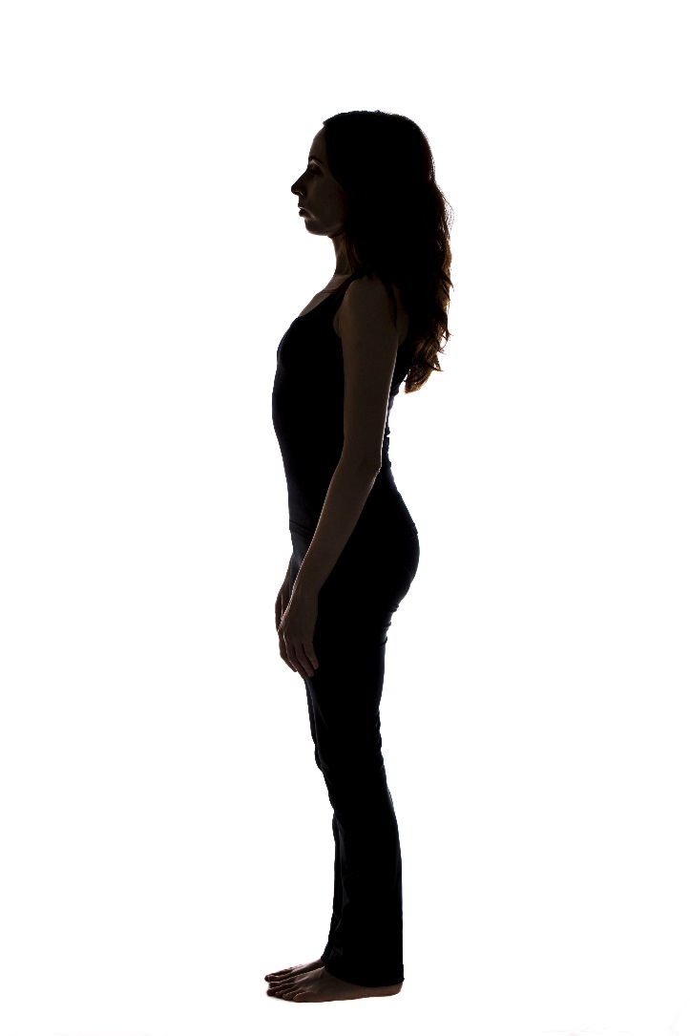
Static posture
Side view
Plumb line:
Anterior to lateral malleolus (ankle)
Midline of knee
Greater trochanter (hip)
Pelvis – ASIS and PSIS
Lumbar spine
Thoracic spine
Midline shoulder (acromion process)
Ear lobe
Crown of head

Slide 21
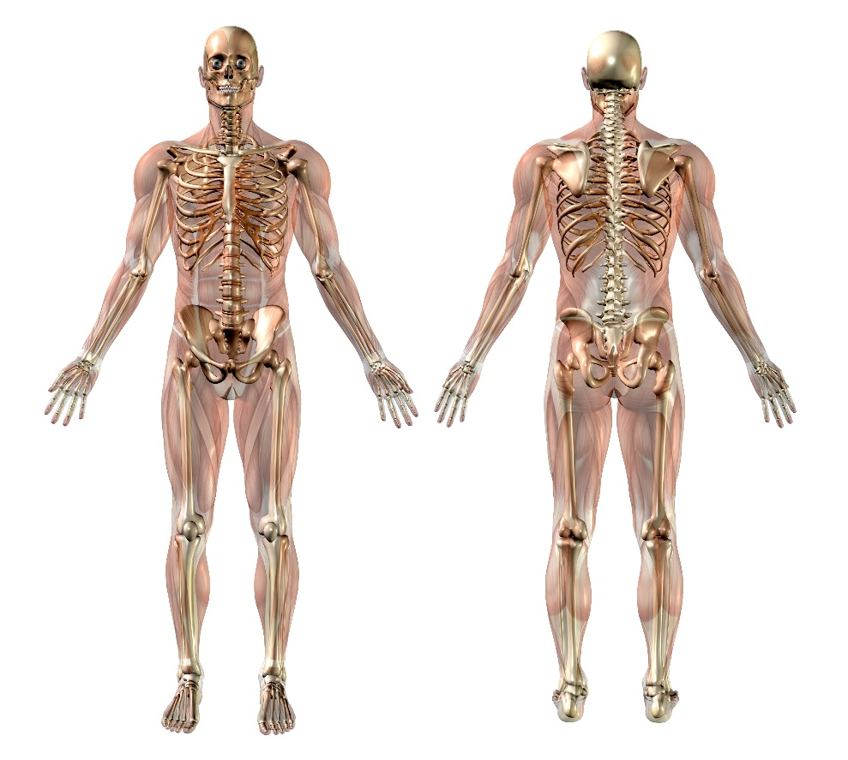
Static posture
Posterior.
Check symmetry:
Head
Shoulders
Waist creases
Hips
Feet turn out
Muscle bulk
Arch of foot-supinated/pronated

Slide 22
Static posture
Anterior.
Check symmetry:
Head
Shoulders
Hips
Knee over 2nd/3rd toe
Feet turned out
Arch of foot - supinated/pronated

Slide 23
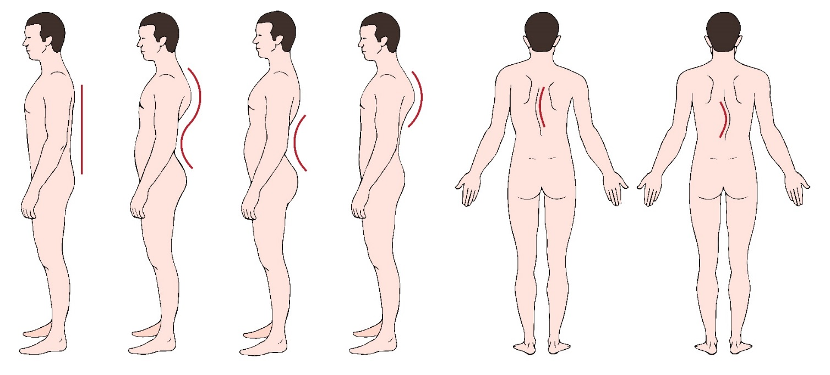
Posture deviations
Flatback | Hyper kyphosis Hyper lordosis | Hyper lordosis | Hyper kyphosis | Scoliosis | Scoliosis

Slide 24
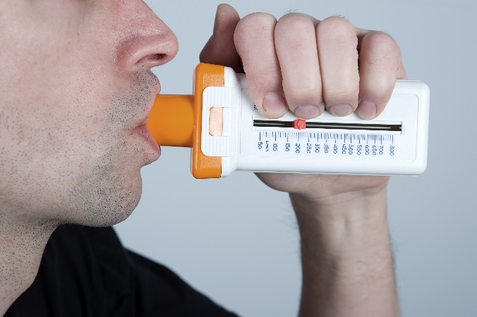
Physical health measures
Health
Pre-exercise heart rate
Pre-exercise blood pressure
Body Mass Index (BMI)
Posture, e.g. plumb line
Body fat measurements
Anthropometric measures, e.g. waist circumference

Slide 25
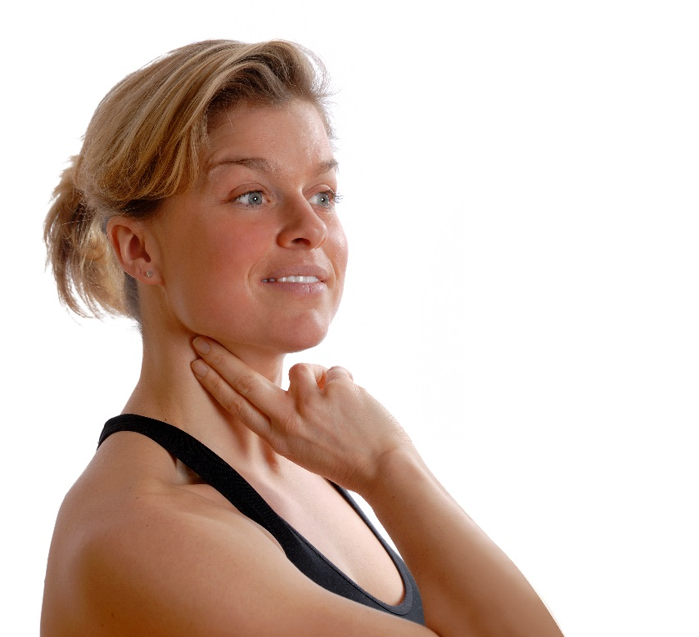
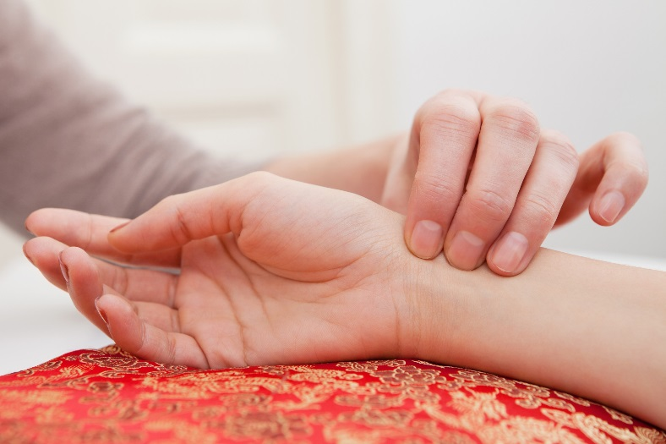
Heart rate

Slide 26
Heart rate
Measures the number of heart beats every minute
Average resting heart rate – 70 beats per minute (bpm)
Resting heart rate taken after a long sleep or rest
Contra-indication: Resting heart rate (100 bpm)
Method:
Let the client rest for 5 to 10 minutes (e.g. seated, no exertion)
Use tips of middle and index finger to locate the radial artery.
Find the pulse
Count pulse for 60 seconds
Record the result
Repeat to check

Slide 27
Blood pressure

Slide 28
Blood pressure
Pressure of blood on heart and blood vessels.
Average – 120/80 systolic – diastolic
Stage 1 hypertension – 140/90 systolic – diastolic
Contraindications = Blood pressure (180/110)
Method:
Let the client rest for 5 to 10 minutes (e.g. seated, no exertion)
Position ambulatory cuff
Inflate
Record the result
Repeat to check

Slide 29
Blood pressure
Classification category | Systolic (mmHg) | Diastolic (mmHg)
Normal | < 120 | < 80
Prehypertension | 120-139 | 80-89
Stage 1 hypertension | 140-159 | 90-99
Stage 2 hypertension | 160-179 | 100-109
ACSM (2014,p46)

Slide 30
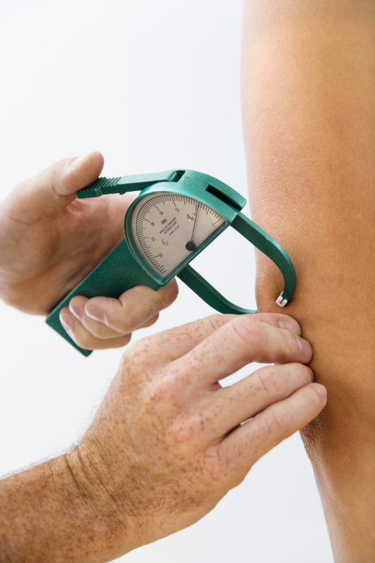
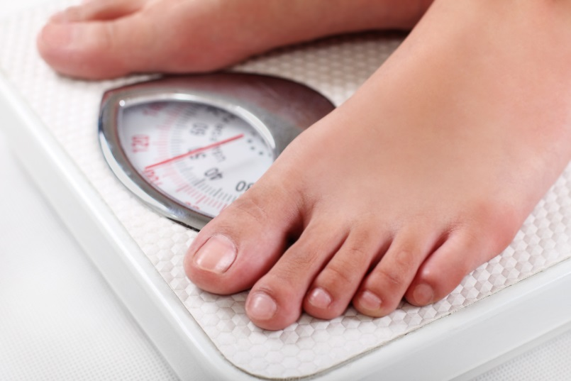
Body weight and composition

Slide 31
Body mass index
Assess obesity and CVD risk
Need clients weight and height to calculate
Contra-indication: BMI (above 30)
Weight in kg
Calculation:
BMI =
Height in m²

Slide 32
BMI classifications
BMI (kg/m2) | Description
<18.5 | Underweight
18.5 to 25 | Normal
25-30 | Overweight
>30 | Obese I
> 35 | Obese II
>40 | Morbidly obese III
Source: World Health Organisation (WHO) 2004. National Institute for Health and Care Excellence (NICE) 2007.

Slide 33
Physical measurements
Fitness assessments:
Cardiovascular fitness
Muscular fitness - strength or endurance
Flexibility & range of movement
Motor skills, e.g. balance
Functional assessments, e.g. sit to stand
Not always relevant or appropriate for exercise referral

Slide 34
Physical measurements
Considerations:
Not all assessments are appropriate for all clients, e.g. inactive, overweight, medical conditions.
Some assessments are too invasive, e.g. body fat calipers.
Validity and reliability of information gathered:
How useful is information?
Is it necessary?
How are assessments conducted?
Equipment, e.g. calibration.
Validity of information.
Norm tables.

Slide 35
Functional assessments
Can help to identify how dysfunctions impact client’s movement in daily life or when participating in exercise or sport.
Observe specific movements, e.g.
Sit to stand from a chair
Walking – stride length, pelvic action
Climbing stairs
Performing specific actions, e.g. lifestyle movement, joint action
Reaching between shoulder blades

Slide 36
Activity
How may client information impact planning?

Slide 37
Using information
All client information should be analysed to ensure safe and effective exercise is planned.
Age, gender and ethnicity – consider:
Any risk of falls, e.g. frail older adults
Any mobility issues
Culturally diverse activities available?
Single sex activities available, e.g. some religions/beliefs
Socio-economic status may affect access, affordability – consider:
Are there any subsidised activities?
What community activities/groups are available
Any funding support?
Individual factors will influence programme design, goals set and equipment used – consider:
Frequency
Intensity
Time
Type
Structure and content of exercise sessions

Slide 38
Using information
Client information will determine the:
The instructor skills and type of session, e.g. Pilates, aqua.
Session structure.
Content, intensity and duration of warm up and cool down.
Content, intensity and duration of main workout.
The components of fitness selected, e.g. cardio, flexibility, muscular.
The equipment used.
The environment used.

Slide 39
Using information
Client information will determine the:
The frequency of exercise
The intensity of exercise:
Repetitions, sets and rest
Resistance, rate, range of motion
The duration of exercise
The type of exercises, e.g. complexity
The level of weight bearing, e.g. seated, water-based

Slide 40
Session structure
Warm up.
Preparing the mind and body
Main activity.
Training specific fitness components
Cool down.
Returning the body to non-exercise state
Consider: Duration, intensity, type of exercises in each component to met needs of individual and medical condition(s).

Slide 41
Activity
What are the legal and ethical implications associated with collecting client information?

Slide 42
Confidentiality and data protection
Follow guidance of legislation
Share information on a ‘need to know’ basis
Store data securely (data protection legislation).
Paper records - locked files
Electronic records - secure systems/passwords
No disclosure to third parties
Transfer information securely
Use information for intended purpose only!
Maintain records for the required duration
Dispose of records securely

Slide 43
Reasons for breaching confidentiality
Any risk of harm to self or others
Not compliant with medication
Suicide risk
Self harm
Maintain boundaries by:
Explain ethical and legal boundaries, e.g. confidentiality and when this would need to be breached during initial consultation
Inform client information will need to be passed on
Record all information

Slide 44
Learning check
Knowledge
Explain the principles of informed consent
Summarise the client/patient information that should be collected when designing an exercise referral programme
Explain how to select the most appropriate methods of collecting client/patient information according to client/patient need
Explain how to interpret information collected from the client/patient in order to identify client/patient needs and goals
Explain the legal and ethical implications of collecting client/patient information

Slide 45
Learning check
Skills
Establish a rapport with client/patient
Explain own role and responsibilities to client/patient
Collect the information needed to plan an exercise referral programme using methods appropriate to the client/patient and their condition/s
Show sensitivity and empathy to client/patient and the information they provide
Record the information using appropriate formats in a way that will aid analysis
Treat confidential information correctly

