Slide 1
Lesson 5 - Health and safety

Slide 2
Learning objectives
By the end of the lesson you will be able to:
Explain the process of pre-activity screening and informed consent for pre and postnatal clients
Describe how to develop an effective working relationship with a pre or postnatal client
Identify the information to be collected by a fitness professional
Describe how to interpret the information gathered, and how to respond
Explain the process of referral

Slide 3
Learning objectives
By the end of the lesson you will be able to:
Describe the legal and ethical responsibilities regarding screening, recording information, record-keeping and client confidentiality
List credible sources of information when working with pre and postnatal clients
Identify support services that are available to pre and postnatal women

Slide 4
The stages of pregnancy
Activity
Discuss and note down the purpose of pre-activity screening and informed consent for pre and postnatal clients.

Slide 5
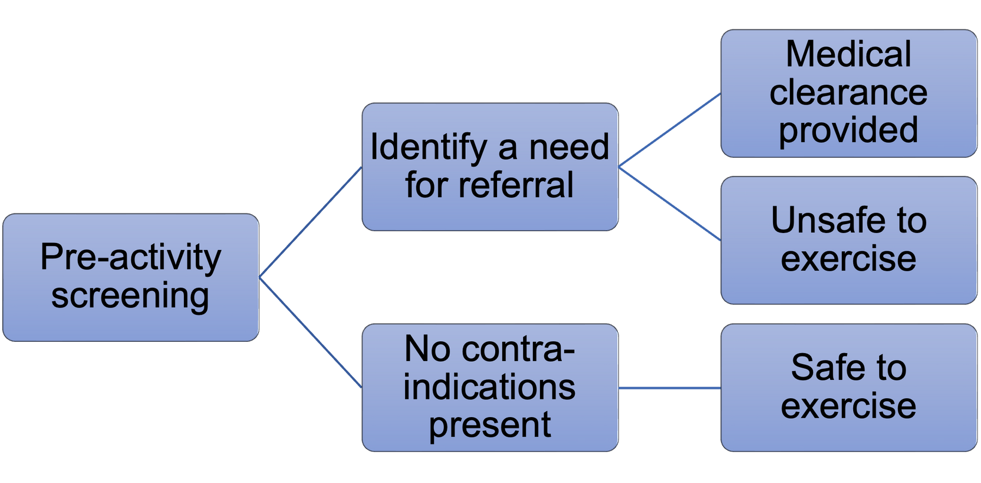
Pre-activity screening

Slide 6
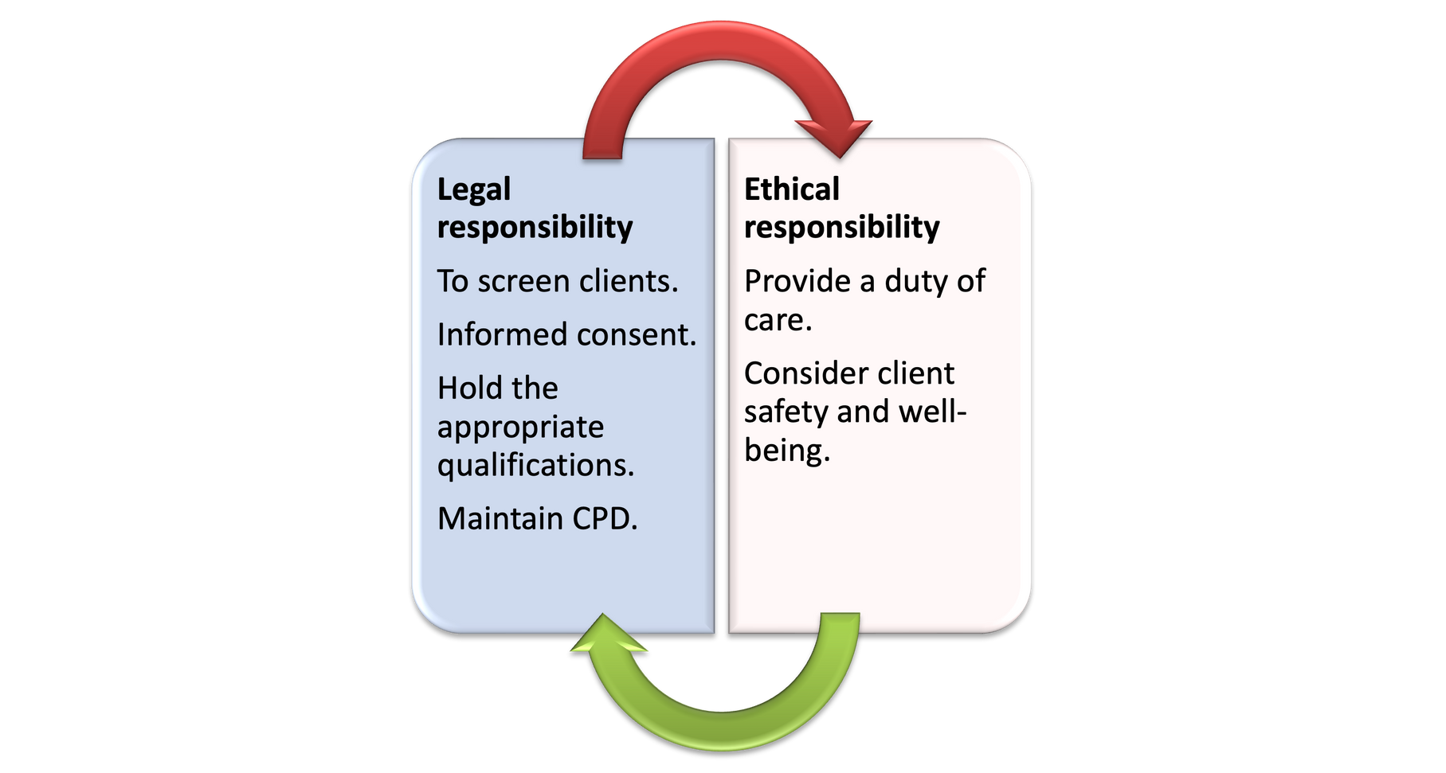
Legal and ethical responsibilities

Slide 7
PARQ
Governs the advice and guidance offered to clients.
Influences the design of a programme of physical activity, including the frequency, intensity, time and type.
Maximises the benefit of exercise in relation to the client’s goals.
Minimises any potential risk of exercise.
Identifies any need to delay exercise or refer to a medical professional.

Slide 8
Signed informed consent
What is being proposed and the rationale behind the exercise programme.
The benefits of the proposed exercise programme.
The risks of the proposed exercise programme.
The responsibilities of everyone involved.

Slide 9
Developing an effective working relationship
Activity
Share a memory of when they ‘got on’ with someone straight away, and explain why they got on so well.

Slide 10
Building and maintaining a rapport
Trust
Being listened to
Active listening
Similar body language
Equal energy
Comfortable communication
Mutual respect

Slide 11
Information to be gathered
Activity
Discuss and note down the information to be gathered when working with pre and postnatal clients, and how to interpret that information.

Slide 12
Information to be gathered
Personal details.
Medical history.
Exercise history
Lifestyle information.
Exercise preferences.
Exercise goals and aims.
Psychological concerns.
Barriers to exercise (perceived or actual).
Medical postnatal check-up and functional fitness.
postnatal check should be performed by a medical professional six weeks after delivery. At this point the ‘all clear’ can be given to participate in exercise. However, a medical professional does not usually perform a Rec Check.

Slide 13
Functional fitness tests
Diastasis recti check | Pelvic floor function check
Tutor to demo a diastasis recti check with a volunteer. In pairs – practise performing a diastasis recti check Q&A – group to feed back and ask questions after practice. | Any of the following can indicate weakness and dysfunction of the pelvic floor muscles: Accidentally leaking urine when coughing, laughing, sneezing or exercising. Needing the toilet in a hurry and not making it in time. Finding it difficult to empty the bladder or bowel or losing control of them. Accidentally passing wind. Pain in the pelvic region. Discomfort during sexual intercourse.

Slide 14
Types of delivery
Types of delivery | Implications for physical activity
Planned Caesarean delivery. Transverse incision of 4–6cm made in the lower abdomen. Abdominals are not cut but are separated along the midline to expose the uterus. | Lack of sensation for up to 12 months around the scar area. Can cause a lack of connection to the pelvic floor and abdominals. Can take considerable time to heal fully; 8–12 week postnatal medical check required before exercise can commence. All clear by a health care professional should be given before returning to work.
Forceps or ventouse (vacuum delivery). | Can result in a small incision or tear, which heals over a number of weeks. Provide cushioned support for seated exercises until healed – a swimming ring is ideal for this. Avoid hard seats such as spin bike.
Episiotomy (an incision made in the perineum to avoid excessive tearing during delivery). | Stitches should heal the wound within one month of delivery. Provide cushioned support for seated exercises until healed – a swimming ring is ideal for this. Avoid hard seats such as spin bike.

Slide 15
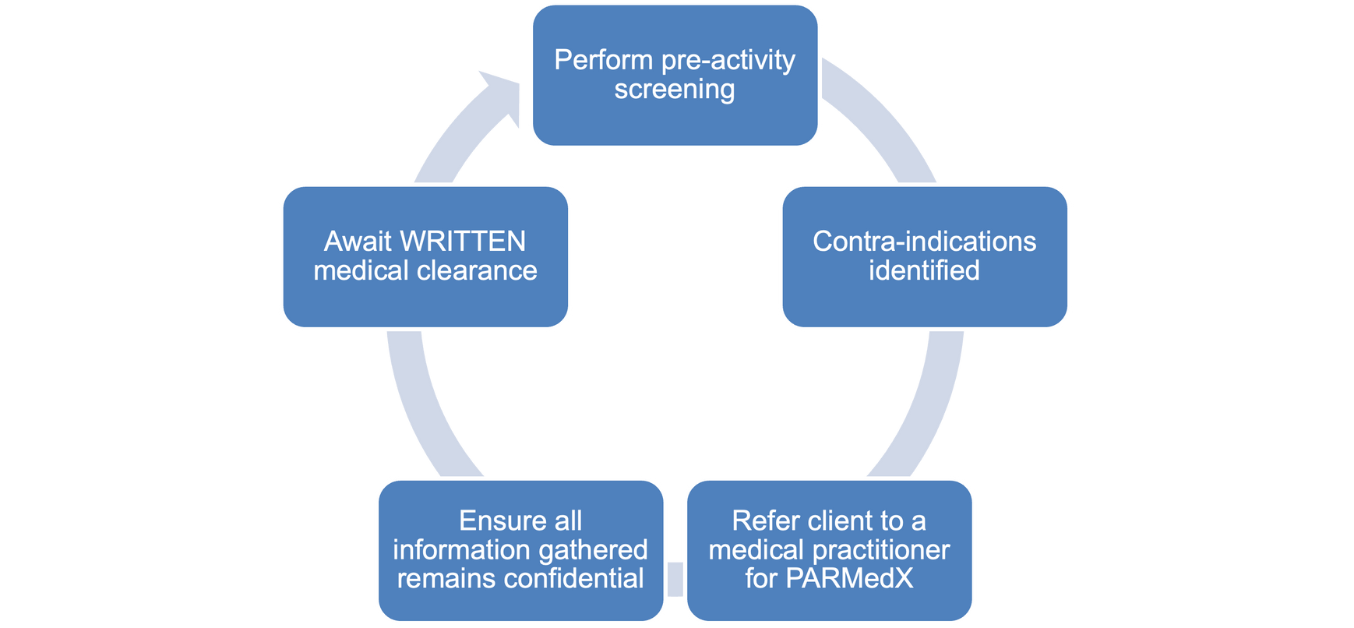
The referral process and confidentiality
Clients with medical conditions need supervised exercise sessions with a suitably qualified L3 exercise referral instructor or a Level 4 specialist instructor.

Slide 16
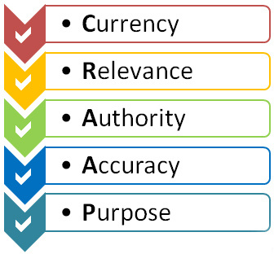
Credible sources of information - CRAPP

Slide 17
Credible sources of information
Registered institutions | Client-friendly sources (referenced)
The American College of Obstetricians and Gynaecologists (ACOG). The Royal College of Obstetricians and Gynaecologists (RCOG). The National Health Service (NHS). The National Centre of Biotechnology (NCBI). Public Health England (PHE). Pelvic, Obsetric and Gynaecology Physiotherapy | Babycentre.co.uk NCT.org.uk (the National Childbirth Trust). Fit Pregnancy for Dummies. The Complete Guide to Pregnancy and Fitness. The Complete Guide to Postnatal Fitness. Start4life https://www.nhs.uk/start4life
The American College of Obstetricians and Gynaecologists (ACOG). The Royal College of Obstetricians and Gynaecologists (RCOG). The National Health Service (NHS). The National Centre of Biotechnology (NCBI). Public Health England (PHE). Pelvic, Obsetric and Gynaecology Physiotherapy | Babycentre.co.uk NCT.org.uk (the National Childbirth Trust). Fit Pregnancy for Dummies. The Complete Guide to Pregnancy and Fitness. The Complete Guide to Postnatal Fitness. Start4life https://www.nhs.uk/start4life

Slide 18
Support services
Activity
Research and note down the purpose of each of the following:
•NHS.
•PANDAS.
•BLISS.
•SANDS.
•Kicks Count.
Children's centres.

Slide 19
Support services
Support service | Help provided
NHS | NHS Choices publishes ‘Your pregnancy and baby guide’, which provides a range of medical and nutritional advice throughout pregnancy, along with expert videos, parents’ tips and interactive tools.
PANDAS | Provides support for coping with pre or postnatal mental illness.
BLISS | Support for families of babies that are born premature or sick.
SANDS | A stillbirth and neonatal death charity.

Slide 20
Support services
Support service | Help provided
Kicks Count | An online information centre for parents, emphasising the importance of tracking the baby’s movements throughout pregnancy.
Children’s centres | Providing support to children and families in the local community and funded by the local council.

Slide 21
Learning review
Can you now:
Explain the process of pre-activity screening and informed consent for pre and postnatal clients?
Describe how to develop an effective working relationship with a pre or postnatal client?
Identify the information to be collected by a fitness professional?
Describe how to interpret information gathered, and how to respond?
Explain the process of referral?

Slide 22
Learning review
Can you now:
Describe the legal and ethical responsibilities regarding screening, recording information, record-keeping and client confidentiality?
List credible sources of information when working with pre and postnatal clients?
Identify support services that are available to pre and postnatal women?

