Slide 1
Conducting subjective and objective assessment
LO1: Anatomy and physiology of the major joints
LO3: Effects of anatomy, physiology and pathology on human function

Slide 2
Assessment criteria
LO1: Understand the anatomy and physiology of the major joints of the body
Identify bony structures associated with the major joints
Explain the functions of bony structures associated with the major joints
Identify soft tissue structures located at the major joints
Explain the function of soft tissue structures located at the major joints
Explain the different types of joint-end feel
LO3: Understand the effects of anatomy, physiology and pathology on human function
Describe the pathophysiology of common injuries/soft tissue dysfunction

Slide 3
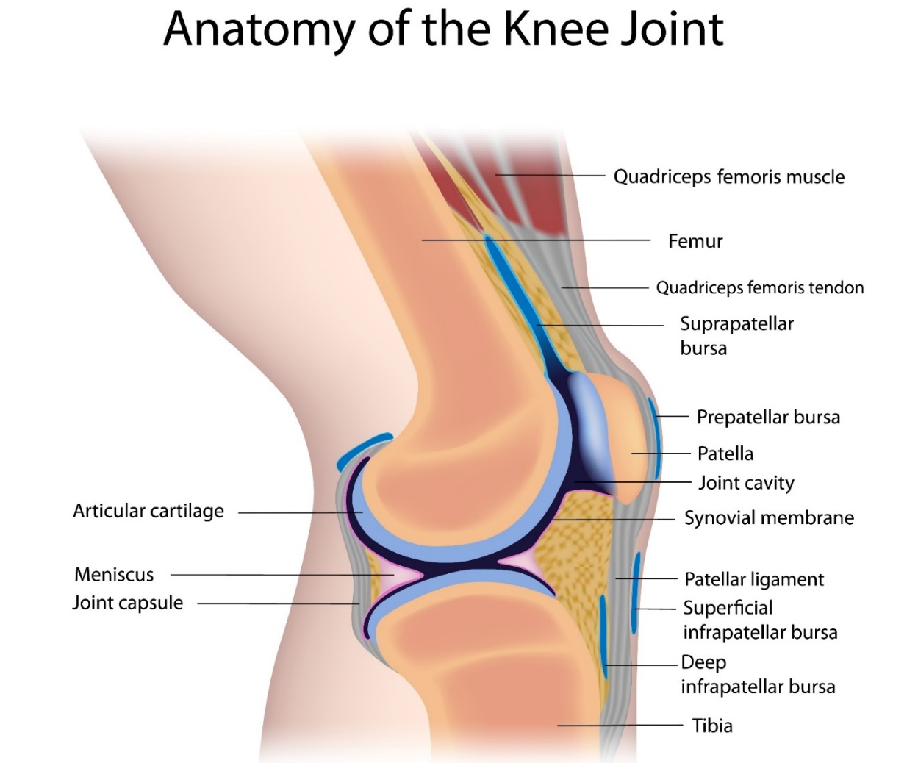
Lateral – side view

Slide 4
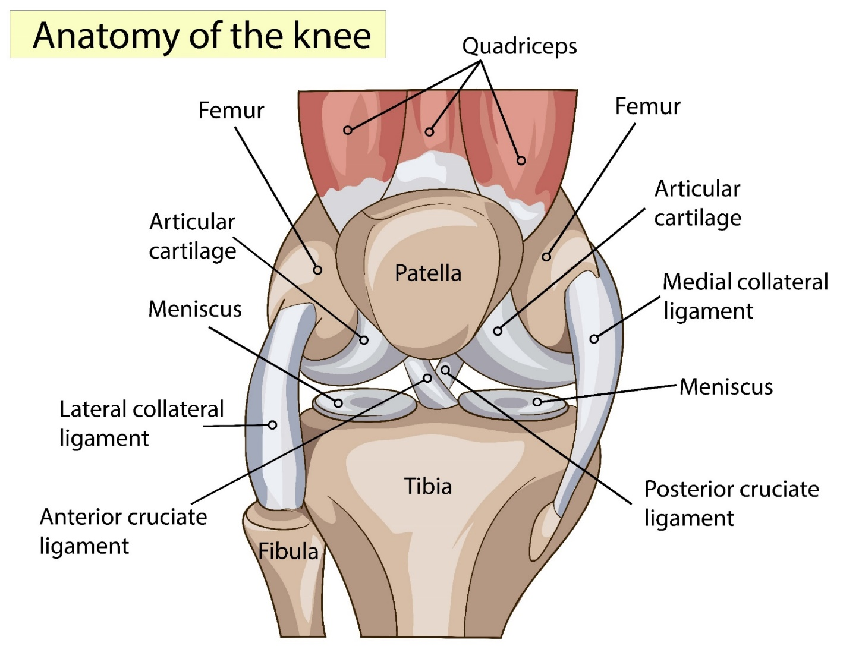
Anterior – front view

Slide 5
Structure of the knee joint
Consists of two synovial joints:
A synovial hinge joint
The tibiofemoral joint – the articulation of the tibial condyles with the femoral condyles
Uniaxial
Move in one plane
A synovial gliding joint
The patellofemoral joint – the articulation of the patella with the femoral groove
Allow movement back and forth and side to side over another surface
Do not move around a point of axis – non-axial

Slide 6
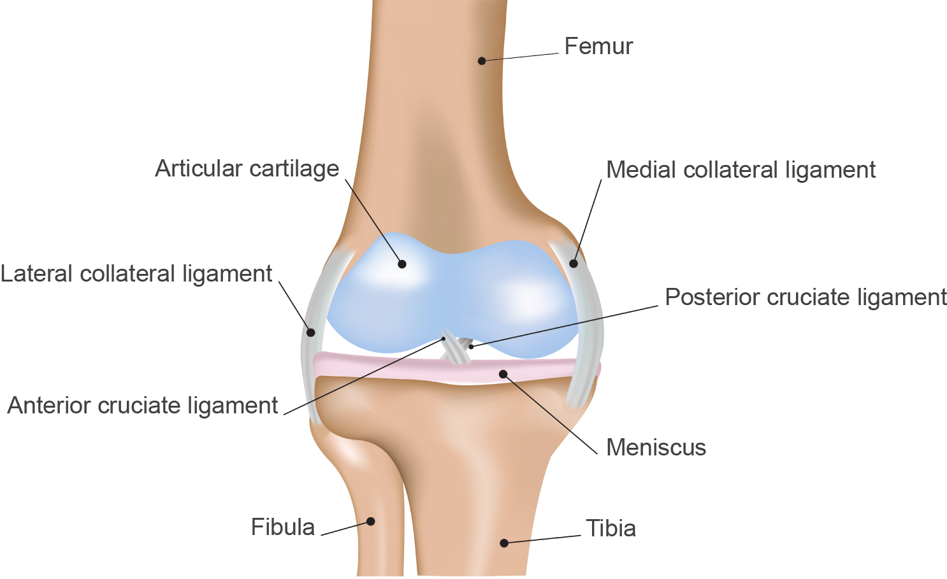
Structure of the knee joint
Femoral condyles
Tibial condyles

Slide 7
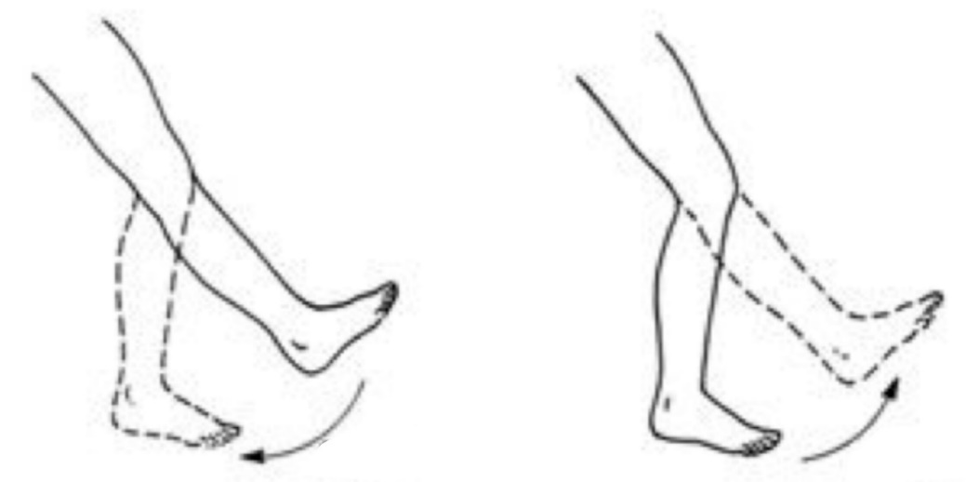
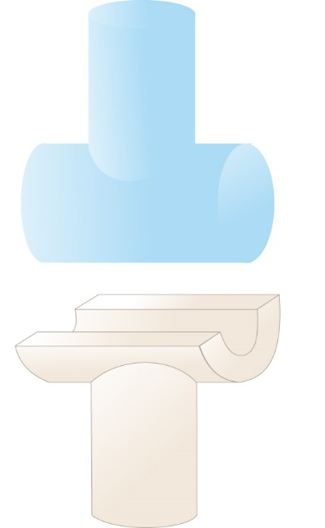
Flexion and extension

Slide 8
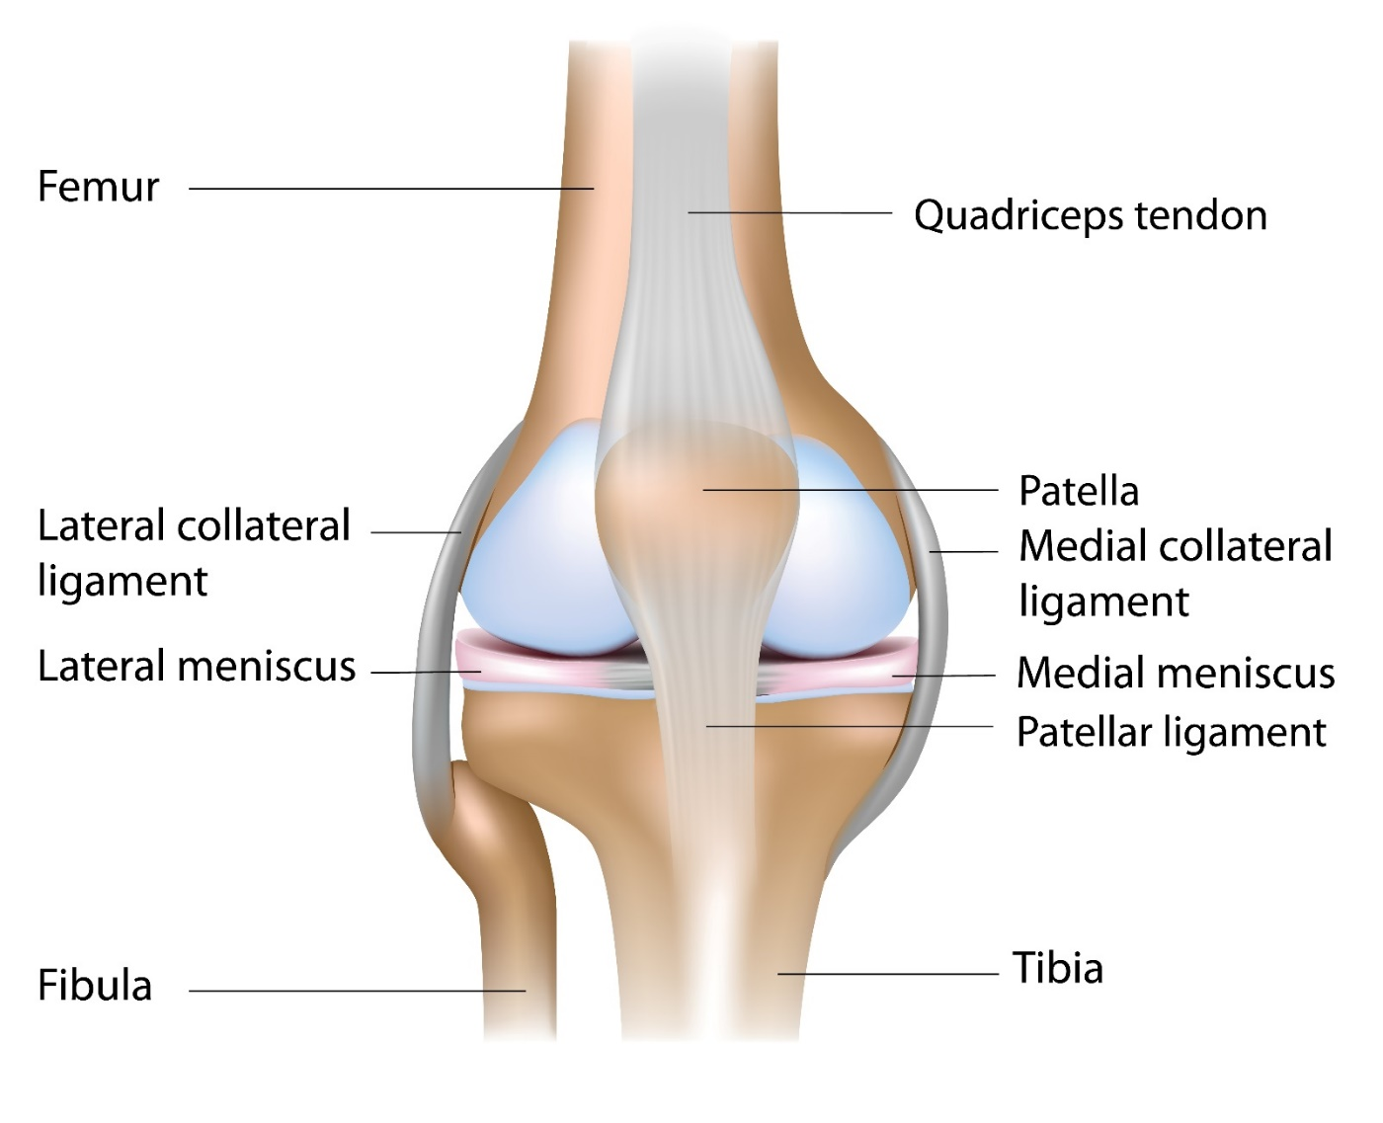
Key bony landmarks
Superior pole of patella
Lateral femoral condyle
Medial femoral condyle
Inferior pole of patella
Head of fibula
Tibial plateau
Tibial tuberosity

Slide 9
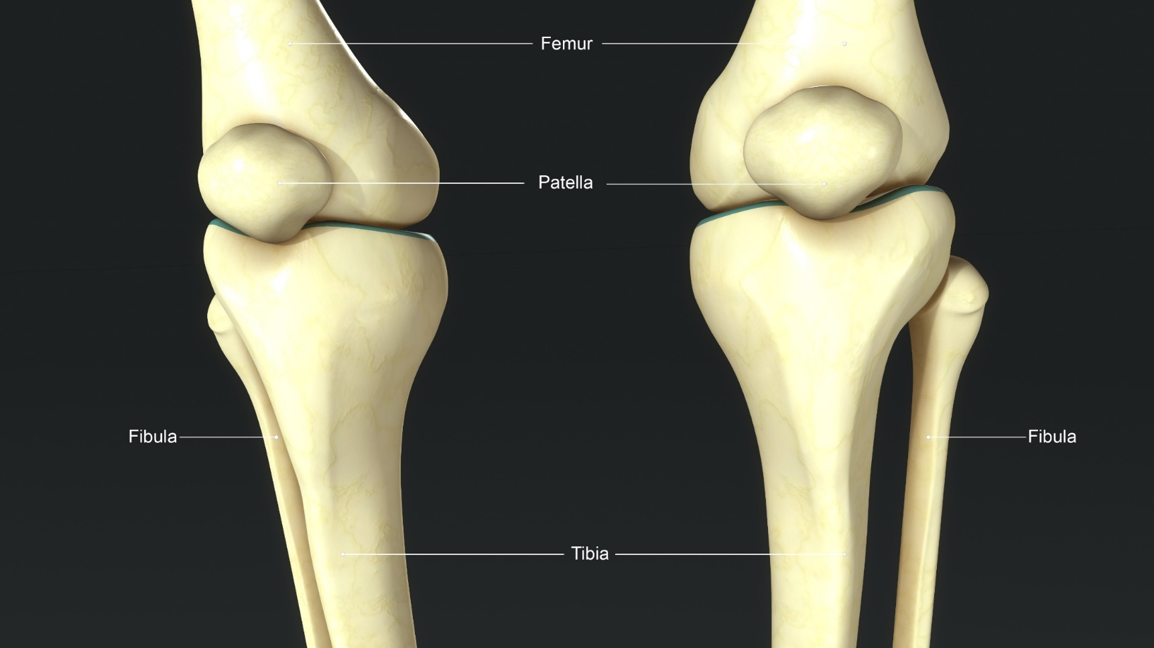
Can you locate and palpate the bony landmarks?

Slide 10

The patella
Knee cap
A sesamoid bone - bone within the patella tendon of the quadriceps
Triangular-shaped
Protects the anterior aspect of the knee
Improves mechanical efficiency of the quadriceps muscles
Posterior surface of patella articulates with the femoral groove

Slide 11
Quadriceps (Q) angle
The Q angle is the angle between two forces:
  The force of the quadriceps pulling the patella in line with the femur
  The force of the patella tendon pulling the patella in line with the tibia
The vastus medialis oblique (VMO) muscle counteracts lateral excursion of the patella
This enables the patella to track smoothly in the femoral groove

Slide 12

Menisici
Menisci

Slide 13
Menisici
Fibrocartilage on the borders of tibial plateau
C shaped
Improves joint congruity
Transfer the load from the upper leg to the lower leg and stabilize the knee during flexion, extension and during rotation movements (improving weight distribution)
Provide shock absorption during weight-bearing activities

Slide 14
Menisici
Reduce friction by providing a smooth, concave surface
Protect hyaline cartilage of the femur and tibia
Increase contact area of joint which improves joint stability
Balance the change of articular surfaces during knee movement forming part of the ‘screw home’ mechanism locking action – maintain extension and prevent hyperextension
Role in joint lubrication
Assist joint rotation

Slide 15
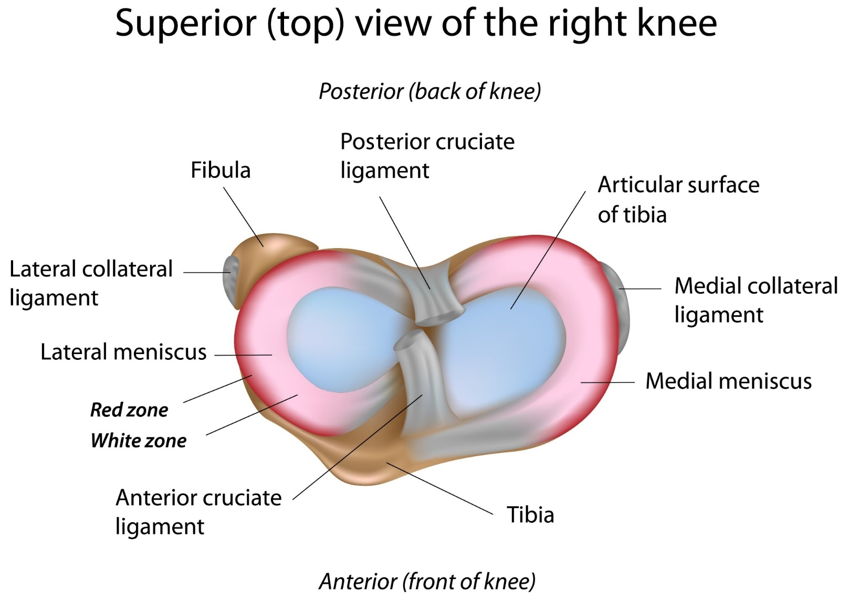

Slide 16
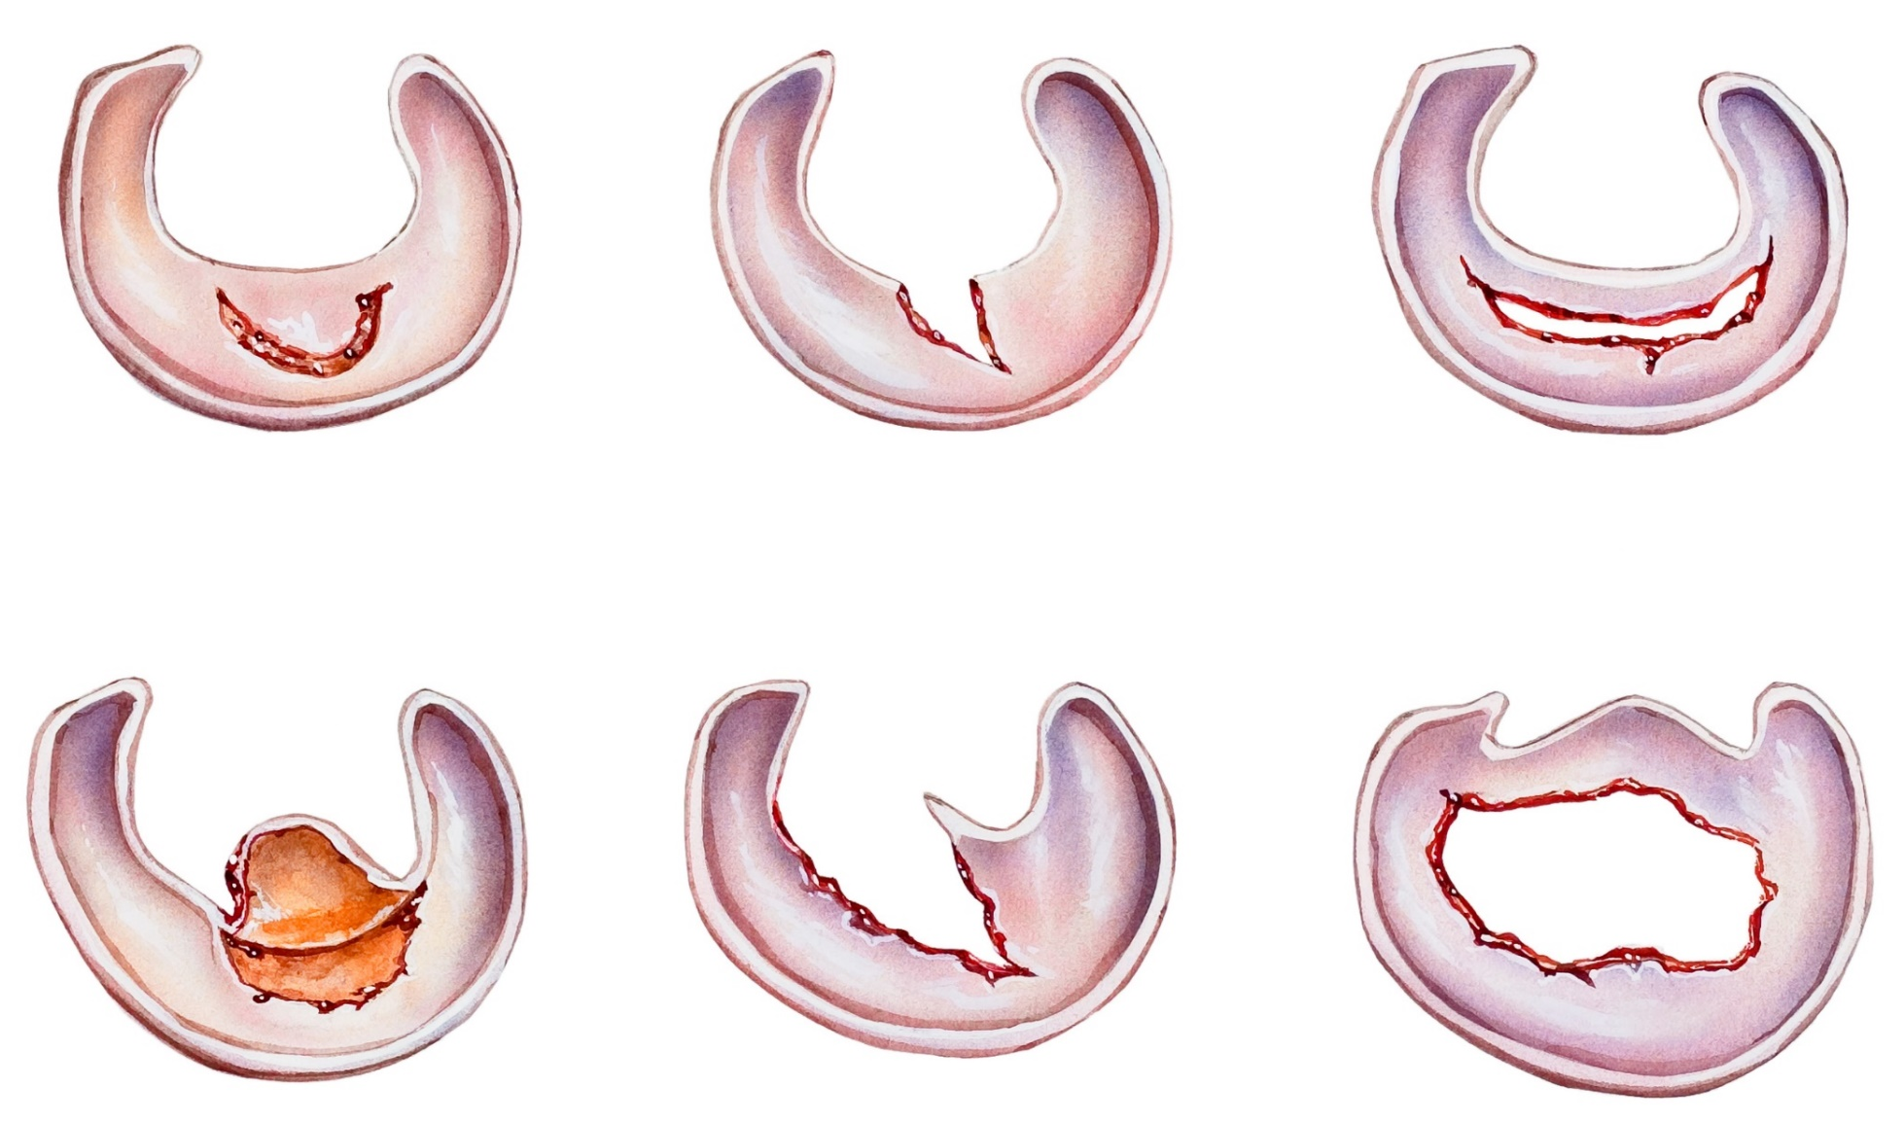
Menisci tears

Slide 17
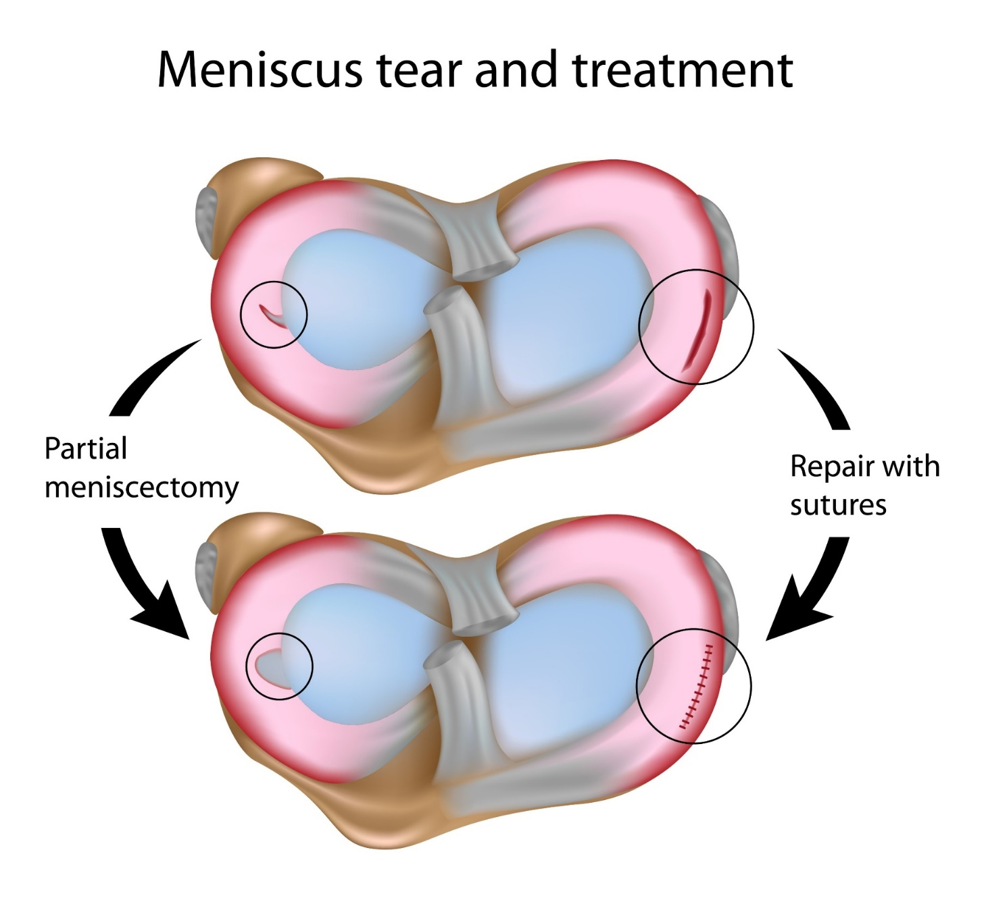

Slide 18
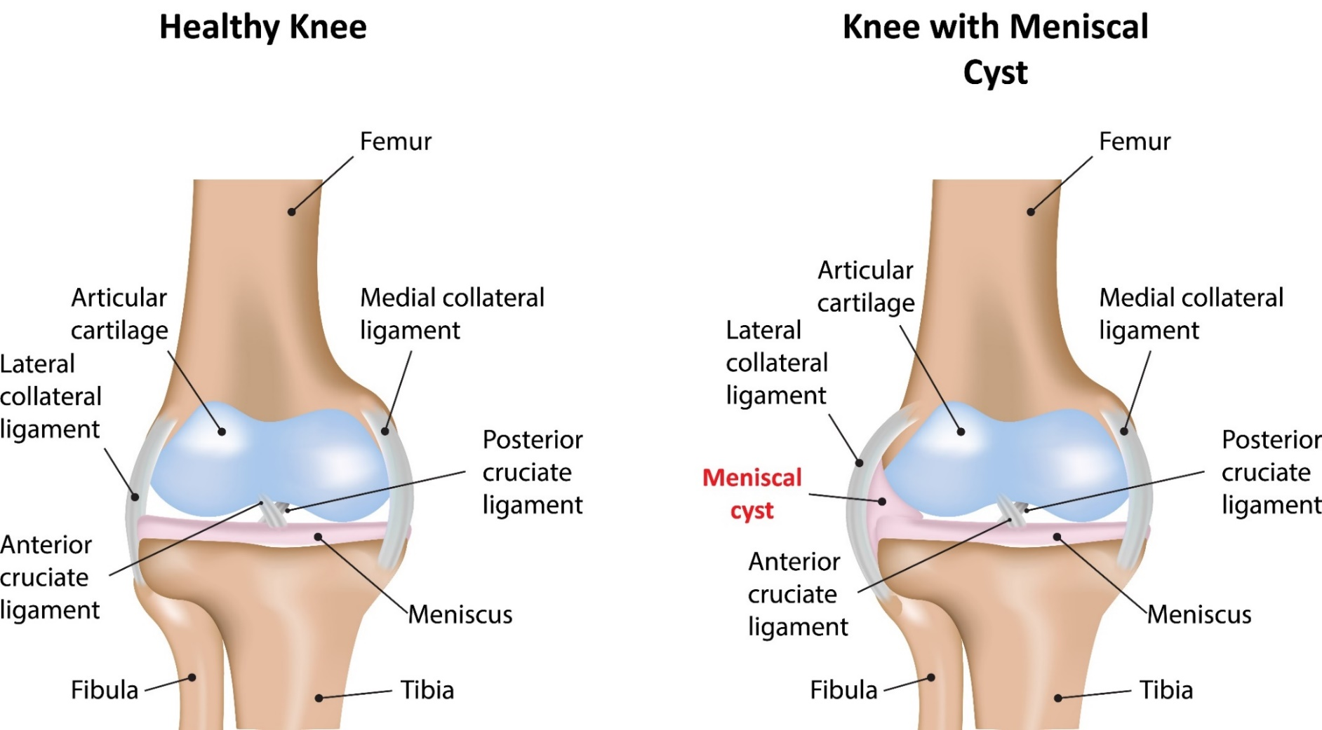
Meniscal Cyst

Slide 19
Knee ligaments
Connect bone to bone across joints
Stabilise joints passively
Poor blood supply
Low extensibility (stretch by up to 6% of their length)
High elasticity (recoil to original length after stretching)
High in collagen (tensile strength)
Small amount of elastin (more extensible)
Knee ligaments
Cruciate ligaments
Collateral ligaments

Slide 20
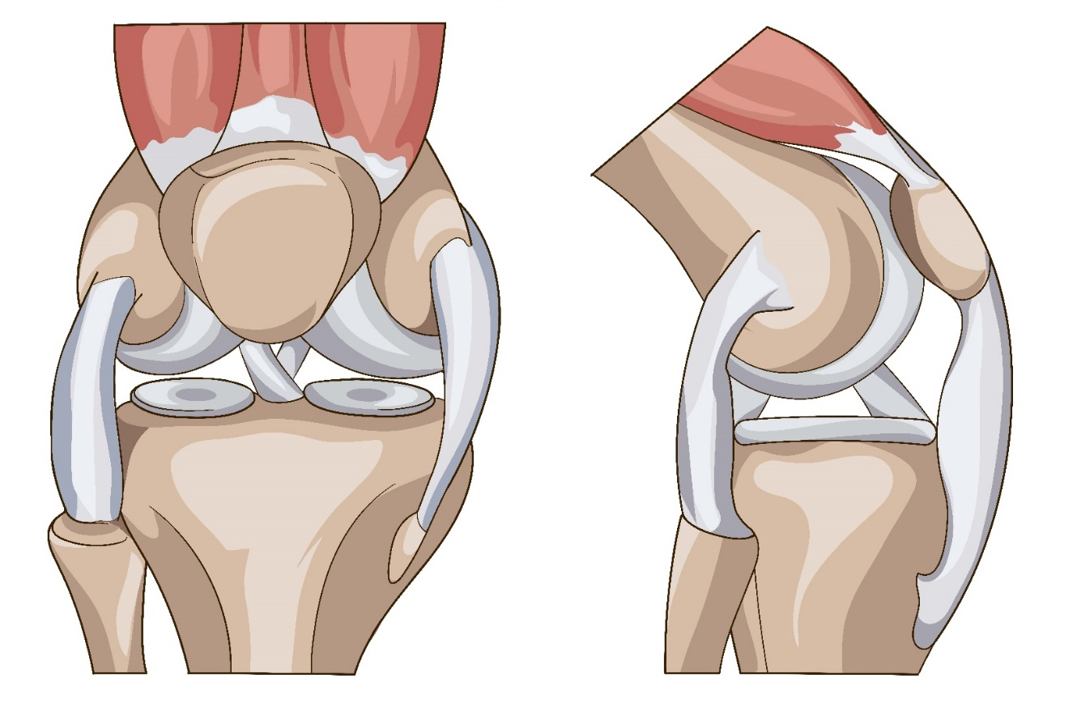
Anatomy of the knee
Medial collateral ligament
Posterior cruciate ligament
Lateral collateral ligament
Anterior cruciate ligament
Anterior view
Side view

Slide 21
Collateral ligaments
Improve stability, limit unwanted movement and provide support and strength in the frontal plane.
Medial collateral ligament
Wide and strap-like
Prevents knee valgus (inward angulation) – ‘knock knees’
Lateral collateral ligament
Short and cord-like
Prevents knee varus (outward angulation) – ‘bow legs’

Slide 22
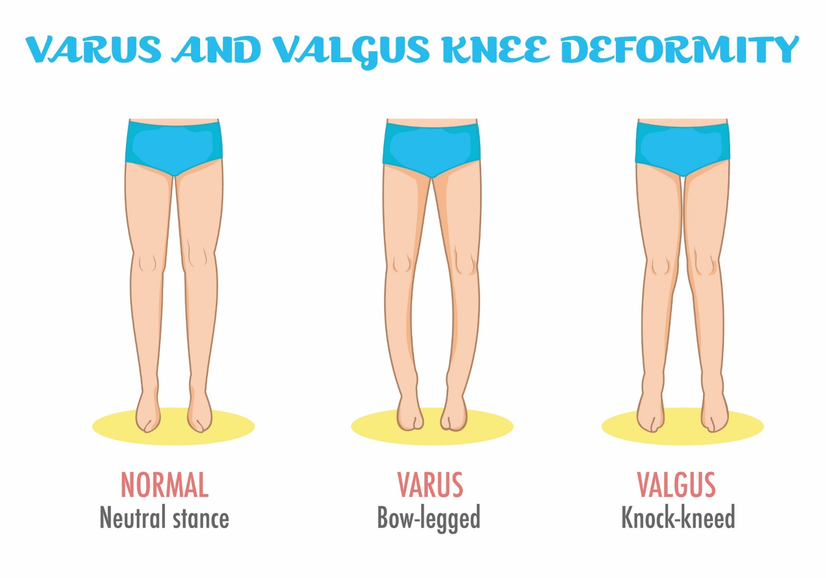

Slide 23
Structure of the knee joint

Slide 24
Cruciate ligaments
Inside the knee joint
Connect the tibial and femoral condyles
Provide stability from inside the knee
Resist rotational forces
Prevent knee hyperflexion and hyperextension
Anterior cruciate ligament (ACL):
Runs posteriorly and superiorly from the anterior tibial plateau to the posterior lateral intercondylar notch
Prevents excess anterior displacement of tibia
Posterior cruciate ligament (PCL):
Runs anteriosuperiorly from the posterior tibial plateau to the medial aspect of the intercondylar notch
Prevents excess posterior displacement of tibia

Slide 25
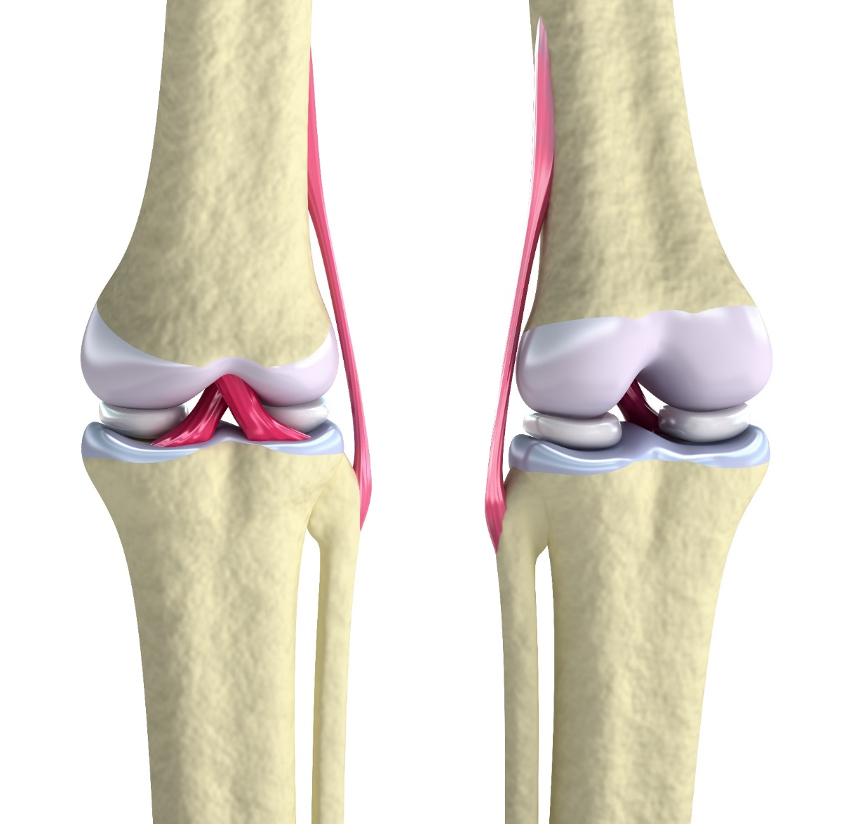

Slide 26
Bursae
Reduce friction and absorb shock
    Suprapatellar bursa – superior to patella (above)
    Prepatellar bursa – anterior surface of patella (front)
    Infrapatellar bursa (deep & superficial) – inferior to patella (below)
    Popliteal bursa – posterior to popliteal muscle (behind)
    Pes anserinus bursa – medial aspect of the tibia (inside)

Slide 27
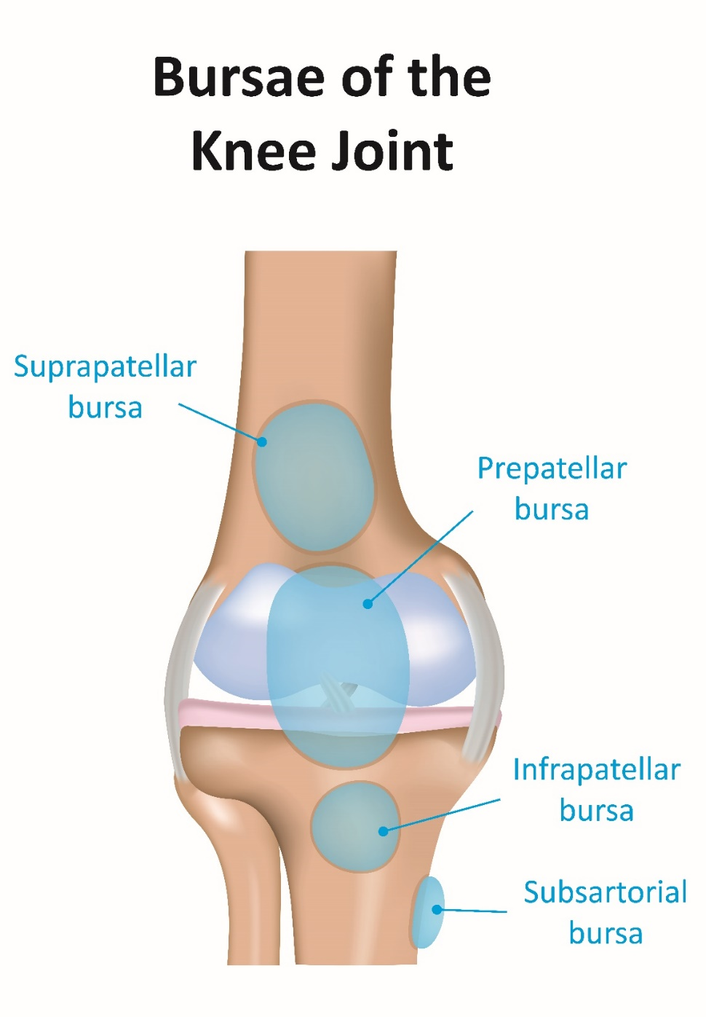

Slide 28
Screw home mechanism
Allows the knee to lock in extension without muscle contraction to enable standing for long durations without excess fatigue.
Courtesy of:
Ligaments – stabilise
Menisci – maintain femur within lip
Condyles – enable automatic rotation during knee flexion and extension

Slide 29

Muscles of the knee
Knee flexion
Biceps femoris
Semimembranosus
Semitendinosus
Gastrocnemius
Popliteus
Sartorius
Gracilis
Plantaris
Knee extension
Rectus femoris
Vastus medialis Vastus intermedius
Vastus lateralis

Slide 30
Muscles of the knee
Knee rotation
Lateral rotation
Biceps femoris
Medial rotation
Sartorius
Gracilis
Popliteus

Slide 31
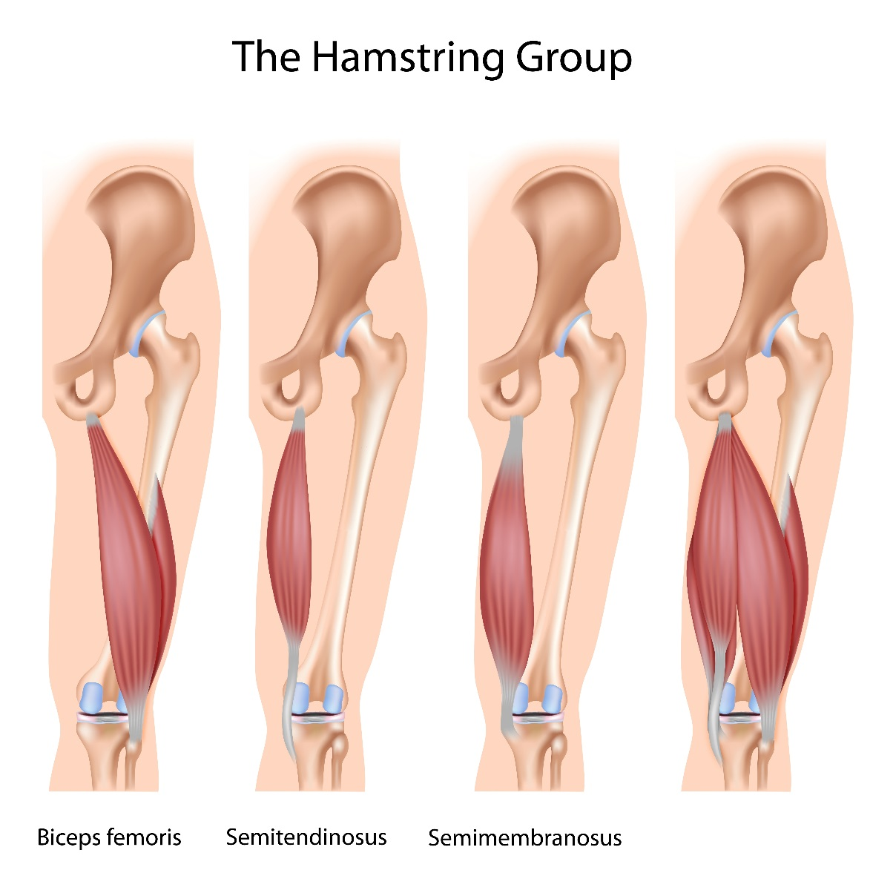

Slide 32
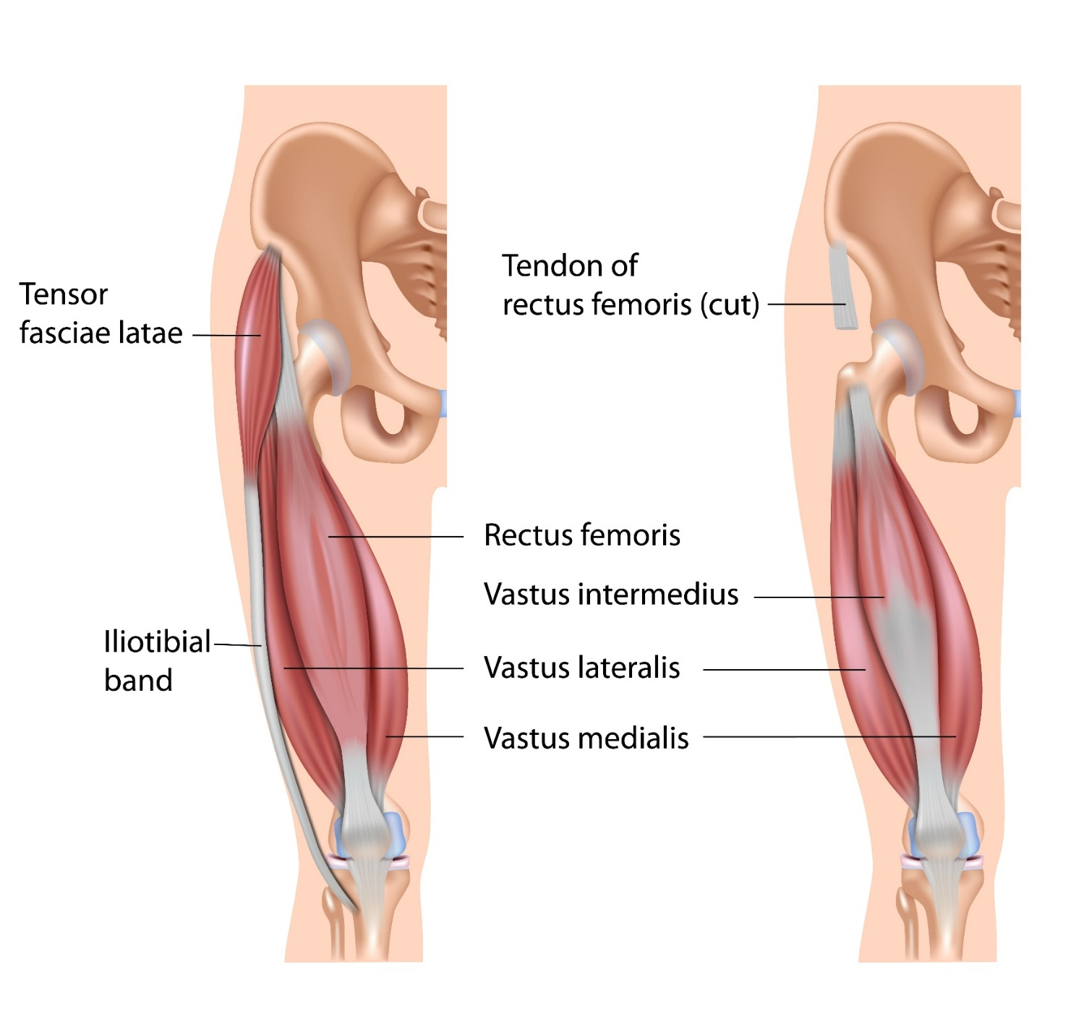

Slide 33
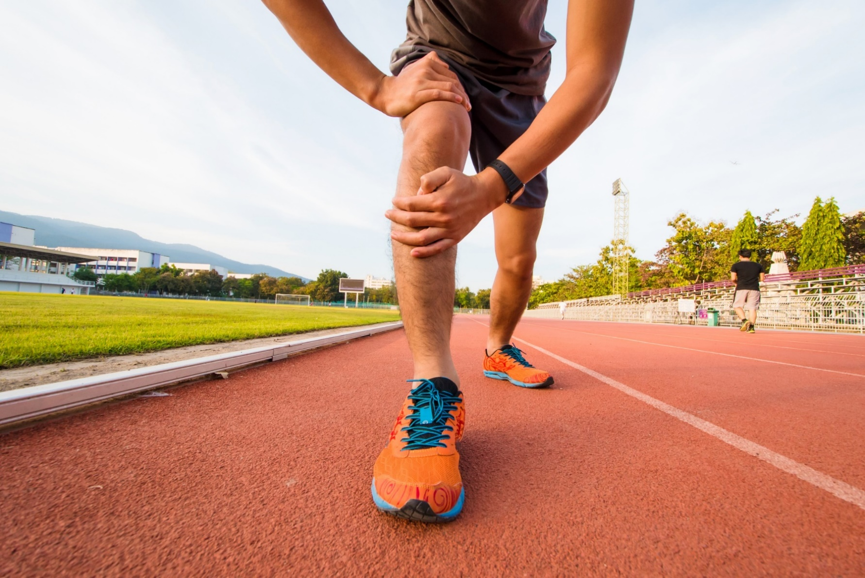
Knee injuries and conditions

Slide 34
Knee injuries and conditions
Knee pain or dysfunction can be primary or secondary
Knee dysfunction may also be a contributory factor for other joint (intrinsic cause)
Example injuries and conditions:
Ligament sprains
Patella tendinopathy
Osgood-Schlatter disease
IT band syndrome
Bursitis

Slide 35
Osgood-Schlatter disease
Sometimes known as Lannelongue's disease or apophysitis of the tibial tubercle
Most commonly seen in adolescents
Caused by adolescent growth spurts or excessive exercise which pulls the patella tendon away from the periosteum at tibial attachment causing inflammation of bone tissue
Additional bone tissue produced and laid down in the area as an attempt to repair damage

Slide 36
Osgood-Schlatter disease
Assessment: Subjective/objective findings
Painful lump below the knee
Pain at tibial attachment of patella tendon
Inflammation at tibial tuberosity
Treatment aims/actions
Minimise activities which aggravate or exacerbate condition
Cryotherapy - reduce swelling and ease pain
Reduce tension in the quadriceps group to decrease
Pressure at insertion

Slide 37
Iliotibial band (ITB) syndrome
Sometime known as runner’s knee
Inflammation
Lateral knee pain caused by friction between the iliotibial band and the lateral epicondyle of femur
Contributory factors/causes
Excessively tight ITB/TFL
Overuse
Excessive foot pronation
Excessive eccentric loading, e.g. downhill running downhill

Slide 38
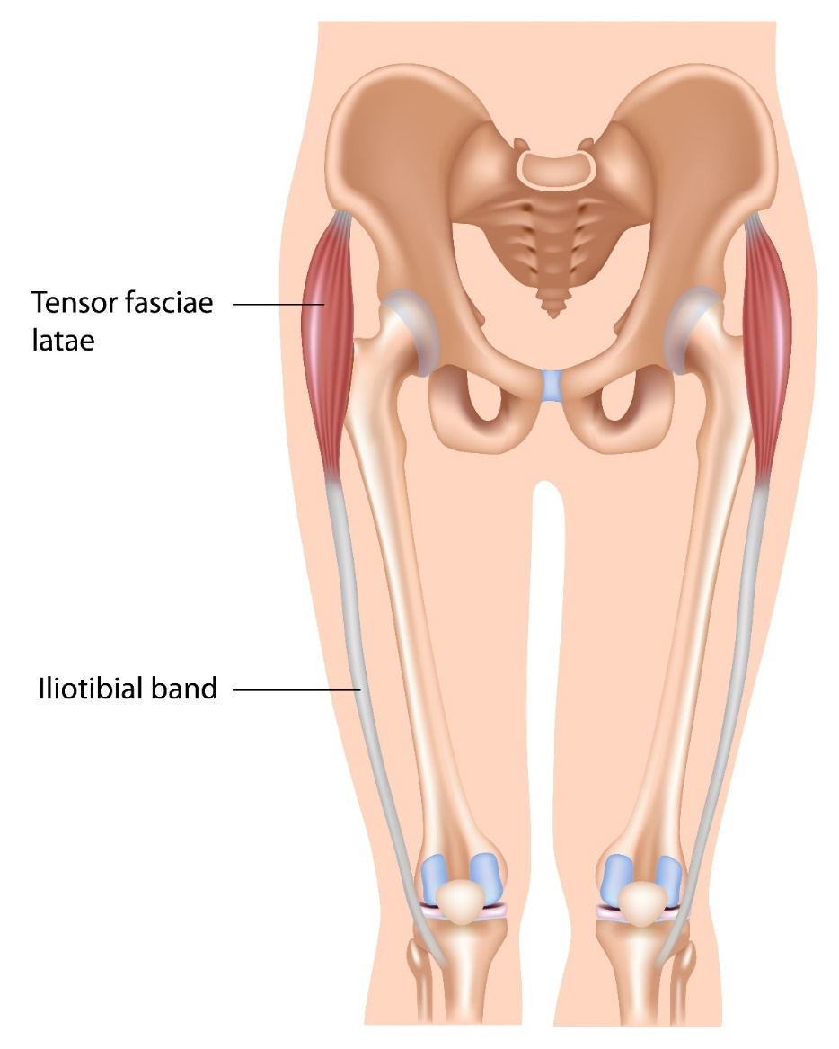
ITB: Assessment findings
Subjective
Client history presents with some causal factors
Sharp pain experienced at the lateral aspect of knee
Pain increases when running, especially downhill
Excessive tightness to lateral structures
Weakness in hip abductors
Objective findings
Positive Ober’s test

Slide 39
ITB treatment aims
PRICE to treat inflammation
Soft tissue therapy to ITB, vastus lateralis, TFL and gluteus maximus
Lengthen short muscles - ITB/TFL/hip adductors
Strengthen inhibited muscles - hip abductors
Check client ROM, strength and proprioception enables them to maintain activities of daily living (ADL) without developing compensatory movements
Check for any secondary conditions

Slide 40
Patellofemoral pain or dysfunction
Misalignment and tracking of the patella
Inflammation
Degeneration, e.g. chondromalacia patellae
Possible contributory factors/causes
Increased q-angle – more common in women
Quadriceps muscular imbalance
Reduced use of quadriceps muscles
Weak vastus medialis oblique (VMO)
Tight vastus lateralis
Past history of participation in weight bearing activities involving knee flexion

Slide 41
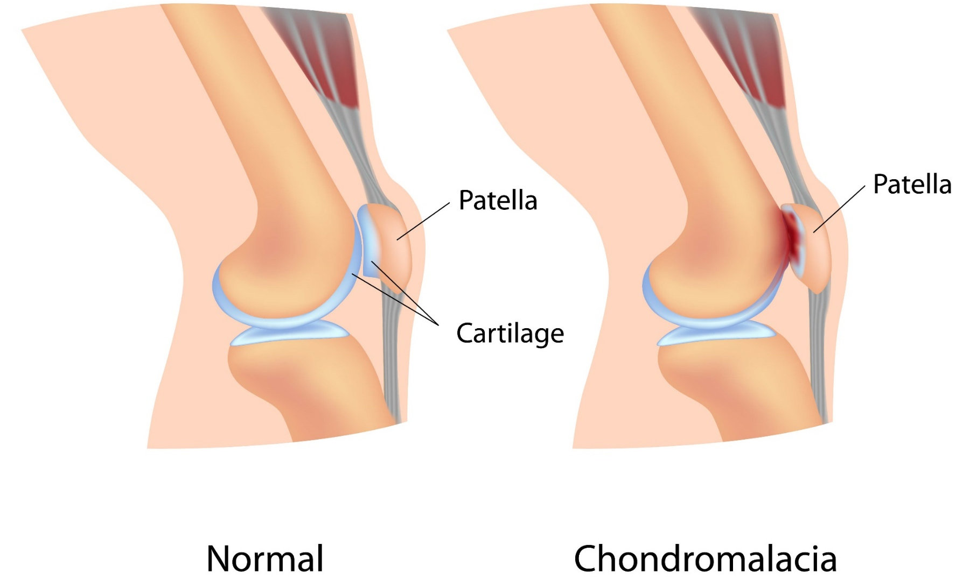

Slide 42
Patellofemoral pain or dysfunction
Assessment findings:
Subjective
Non-specific / vague location of pain anterior to the knee
Objective
Patella misalignment visible during functional testing
VMO atrophy
Genu valgum ‘knock knees’
Over pronation of the foot
Increased femoral internal rotation
Excessive tighness in lateral structures

Slide 43


Slide 44
Patellofemoral pain or dysfunction
Treatment aims
PRICE – to treat inflammation
Strengthen inhibited muscles (VMO)
Soft tissue therapy to tight structures
Lengthen tight or short muscles (lateral structures)
Address over pronation if necessary
Check client ROM, strength and proprioception enables them to maintain activities of daily living (ADL) without developing compensatory movements
Check for any secondary conditions
Signpost to GP if treatment (massage or exercises) cause inflammation

Slide 45
Patella tendinopathy
Sometimes known as jumper’s knee or patella tendinosis
Excessive loading through tendon
Pain often associated with the phase of tendinopathy
Inflammation of patella tendon (tendinitis: uncommon in most tendinopathies)
Disorganisation of collagen and thickening of patella tendon
Treatment aims
Minimise any activities (e.g. explosive movements) which aggravate condition
Cryotherapy to reduce swelling and pain
Progressive rehabilitation (eccentric loading?)
Lengthen rectus femoris to reduce tension on patella tendon

Slide 46
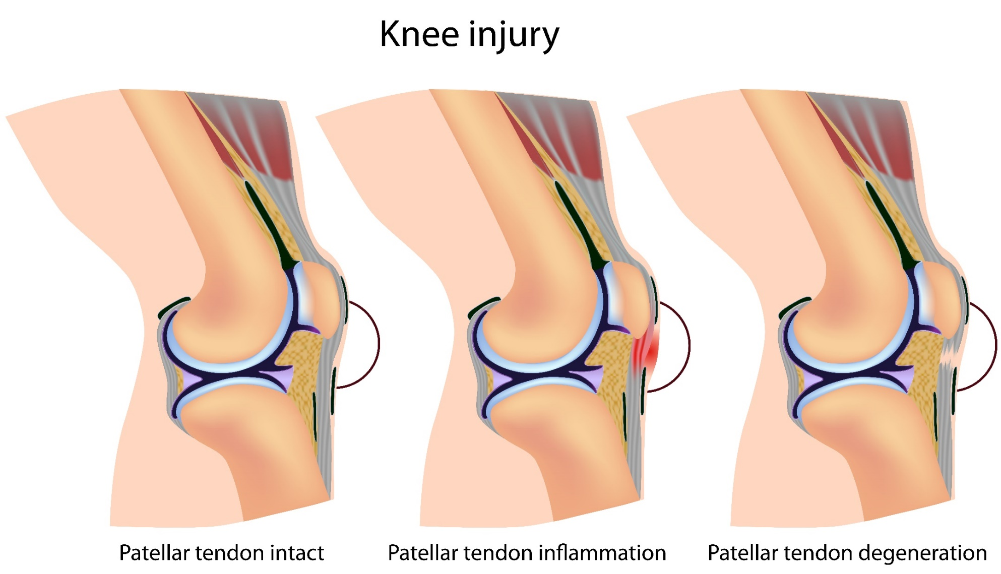

Slide 47
Bursitis
Sometimes known as housemaid’s knee
Swelling
Pain and tenderness
Reduced range of movement
Contributory factors and causes
Increased friction due to changes in movement pattern or sustained movement pattern (e.g. kneeling)
Overuse
High impact
Treatment aims
Minimise activities (e.g. explosive movements) which aggravate condition
Cryotherapy to reduce swelling and pain
Assess musculature to identify tension or excessive friction placed on bursa

Slide 48
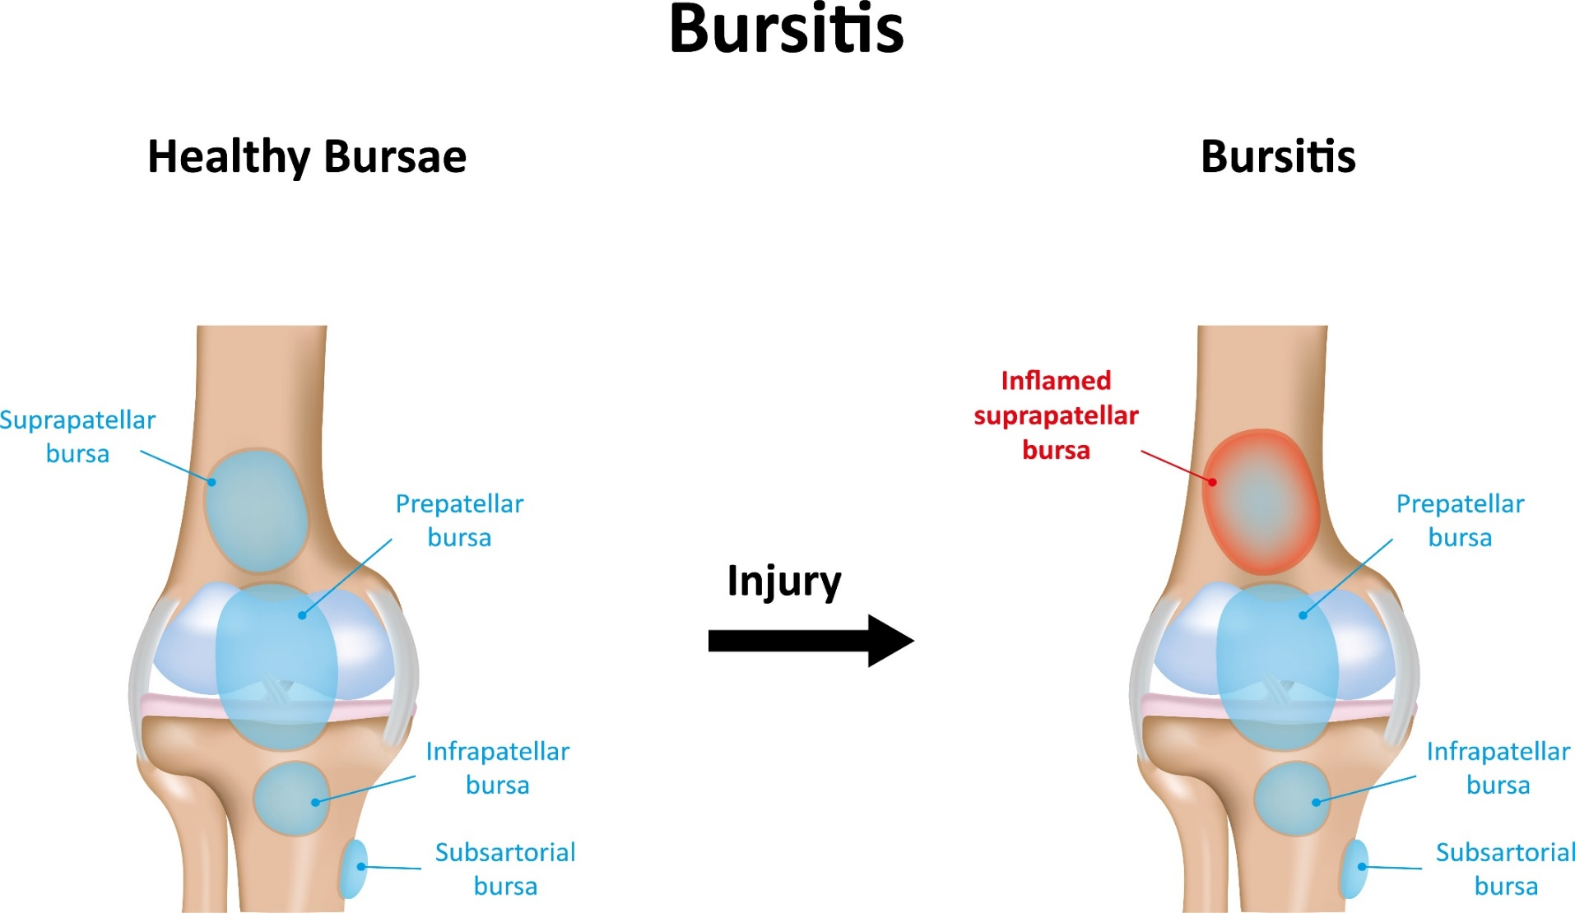

Slide 49
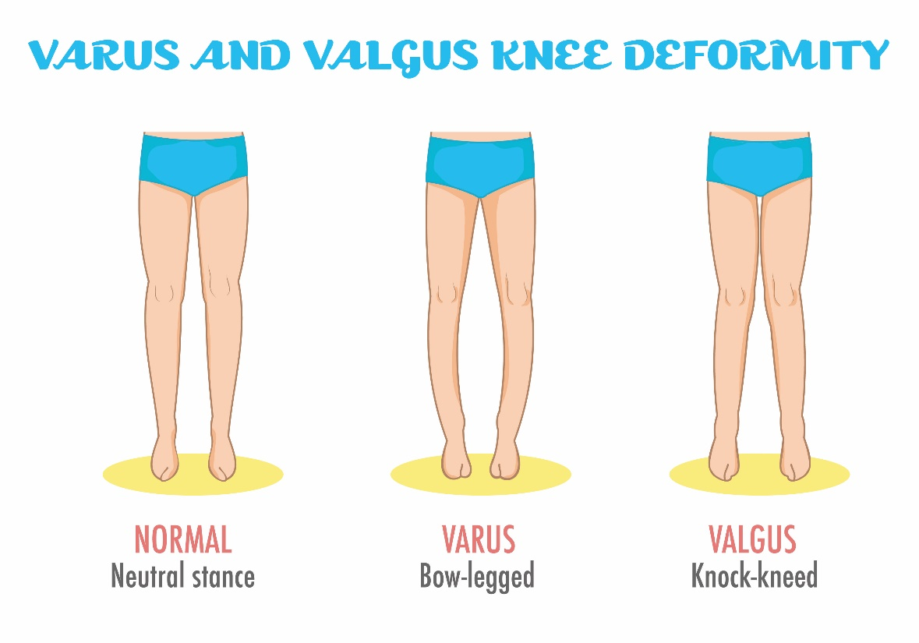
Ligament injuries (sprains)
Medial or lateral collateral sprain
Excessive valgus force will damage medial collateral ligament
Excessive varus force will damage lateral collateral ligament

Slide 50
Ligament injuries (sprains)
Medial or lateral collateral sprain
Assessment findings:
Pain affecting medial or lateral joint line
Heat (without swelling)
Instability
Positive special test

Slide 51
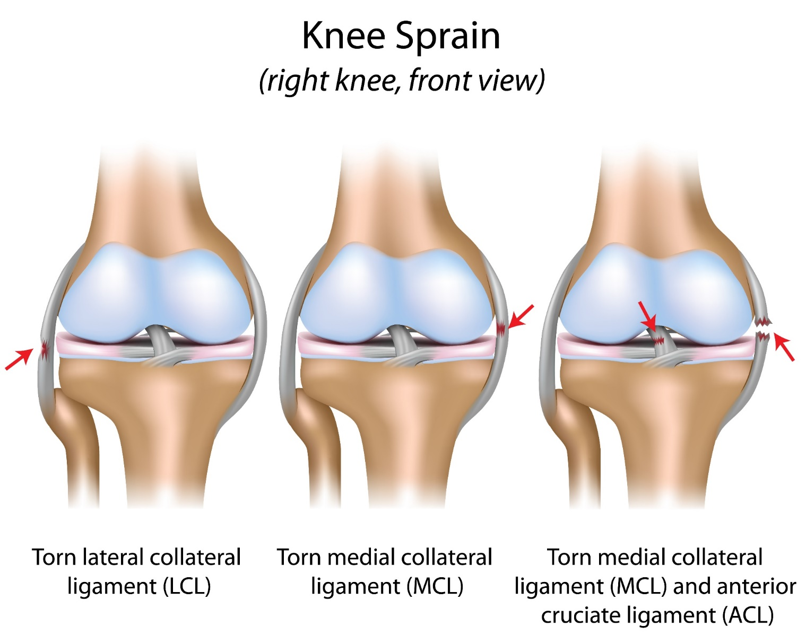

Slide 52
Ligament injuries (sprains)
Anterior or posterior cruciate ligament sprain
    Causal factors:
    Anterior sprain (ACL) – rapid or excessive knee rotation and valgus displacement of the knee, rapid deceleration
    Posterior sprain (PCL) – impact to the front of the knee when the leg is extended or hyperextended or dynamic rotational forces at knee
    Assessment:
Pain deep in the joint
Heat
    Rapid, severe swelling of the joint
    Joint laxity (initially)
    Reduced range of motion

Slide 53
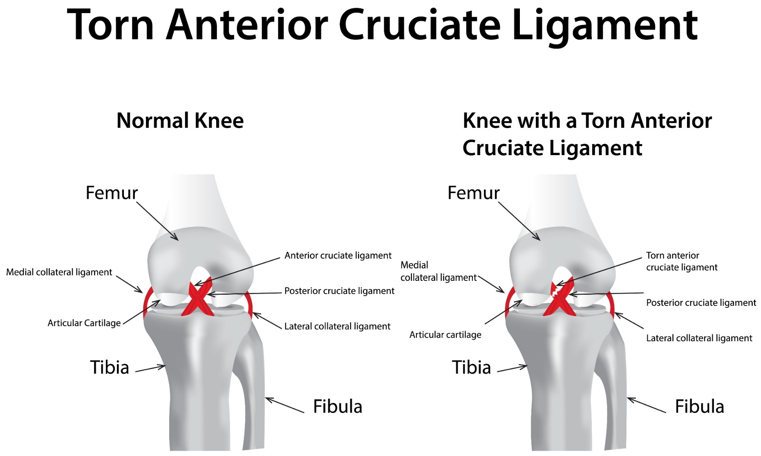

Slide 54
Ligament injuries (sprains)
Treatment:
Cryotherapy - reduce swelling and pain
Check mechanism of injury and reduce causal factors, e.g. repetitive movements
Mobilise after acute phase to reduce the risk of adhesions and prevent against protective spasms becoming a permanent adaptive change affecting muscle length
Improve stability by strengthening supporting musculature
Specific exercise therapy and gradual return to sport
Signpost to GP if severe pain or excessive instability

Slide 55
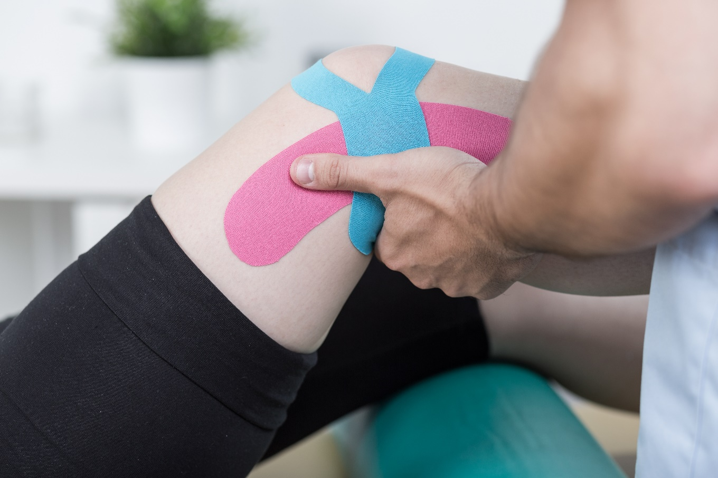
Other knee conditions/injuries

Slide 56
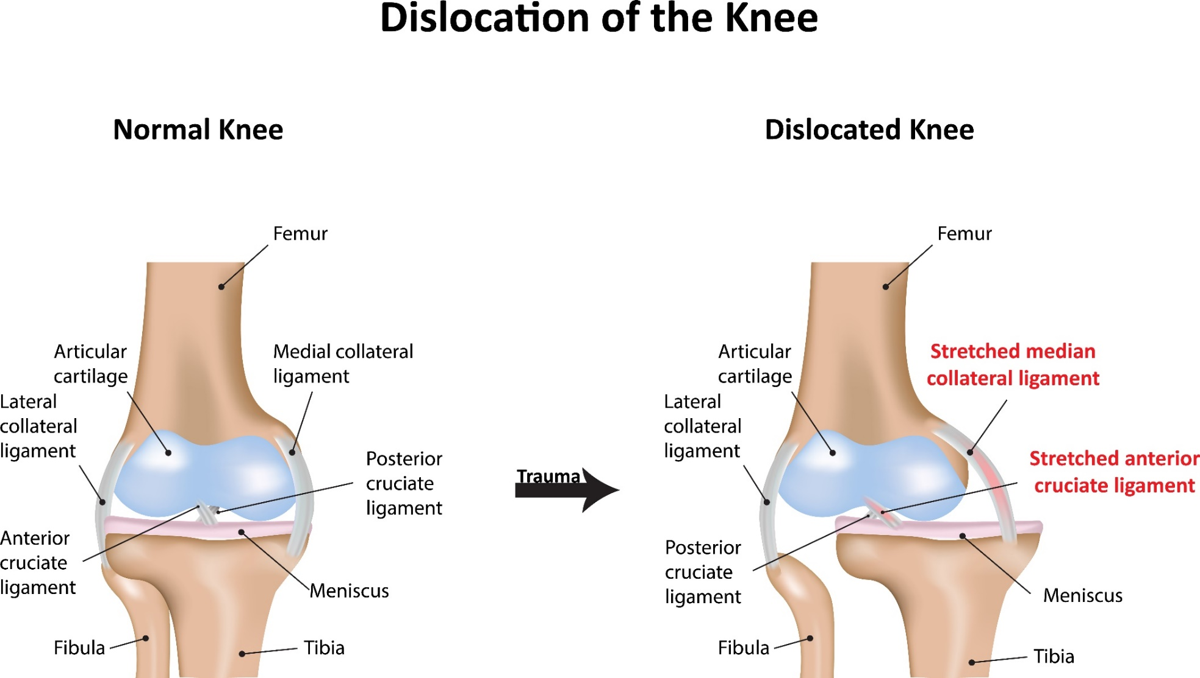

Slide 57
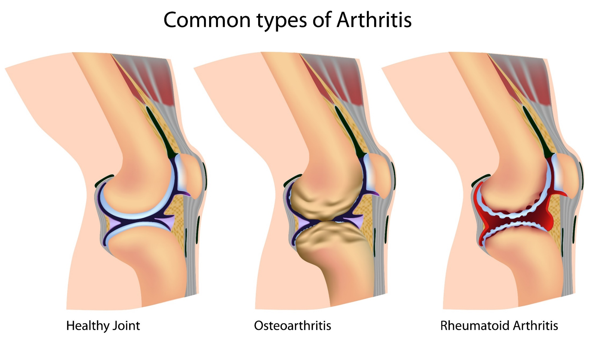

Slide 58
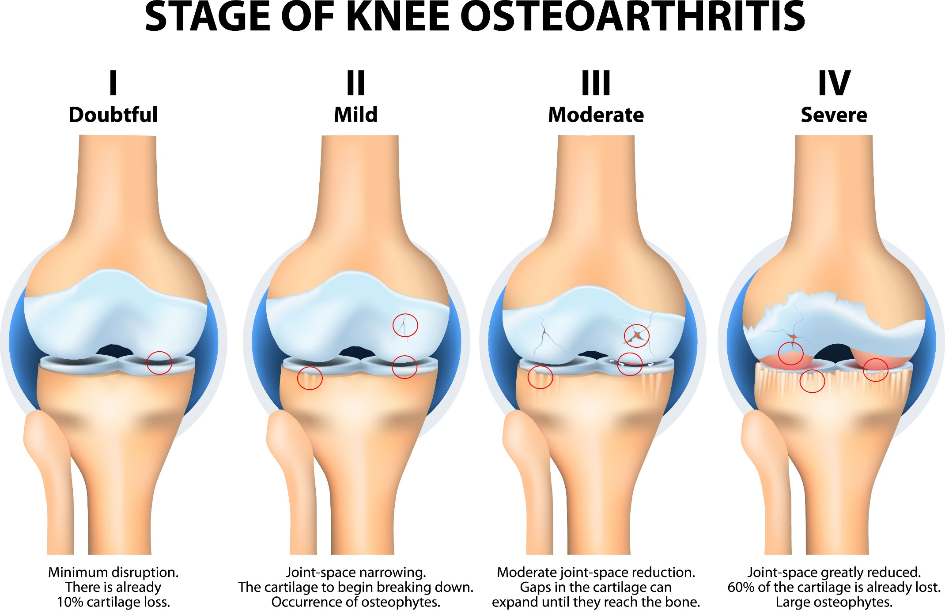

Slide 59
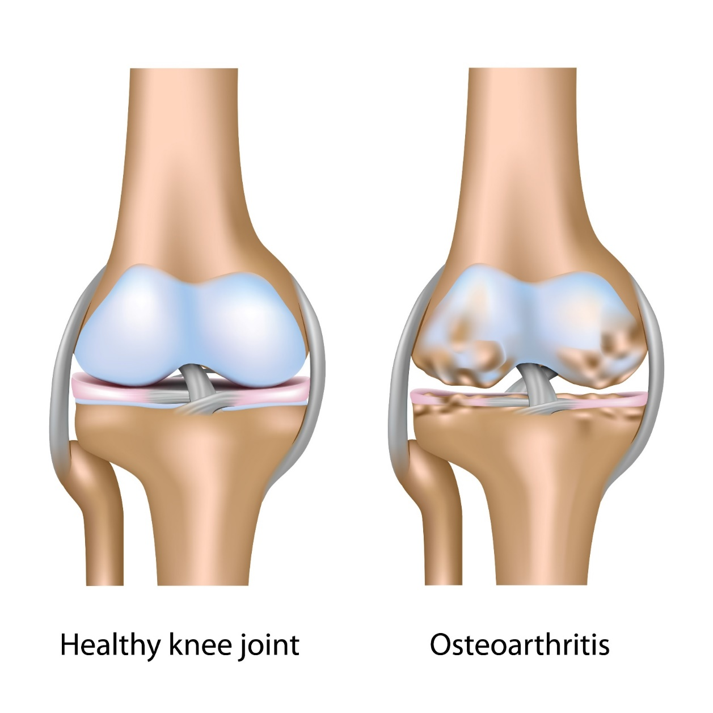

Slide 60
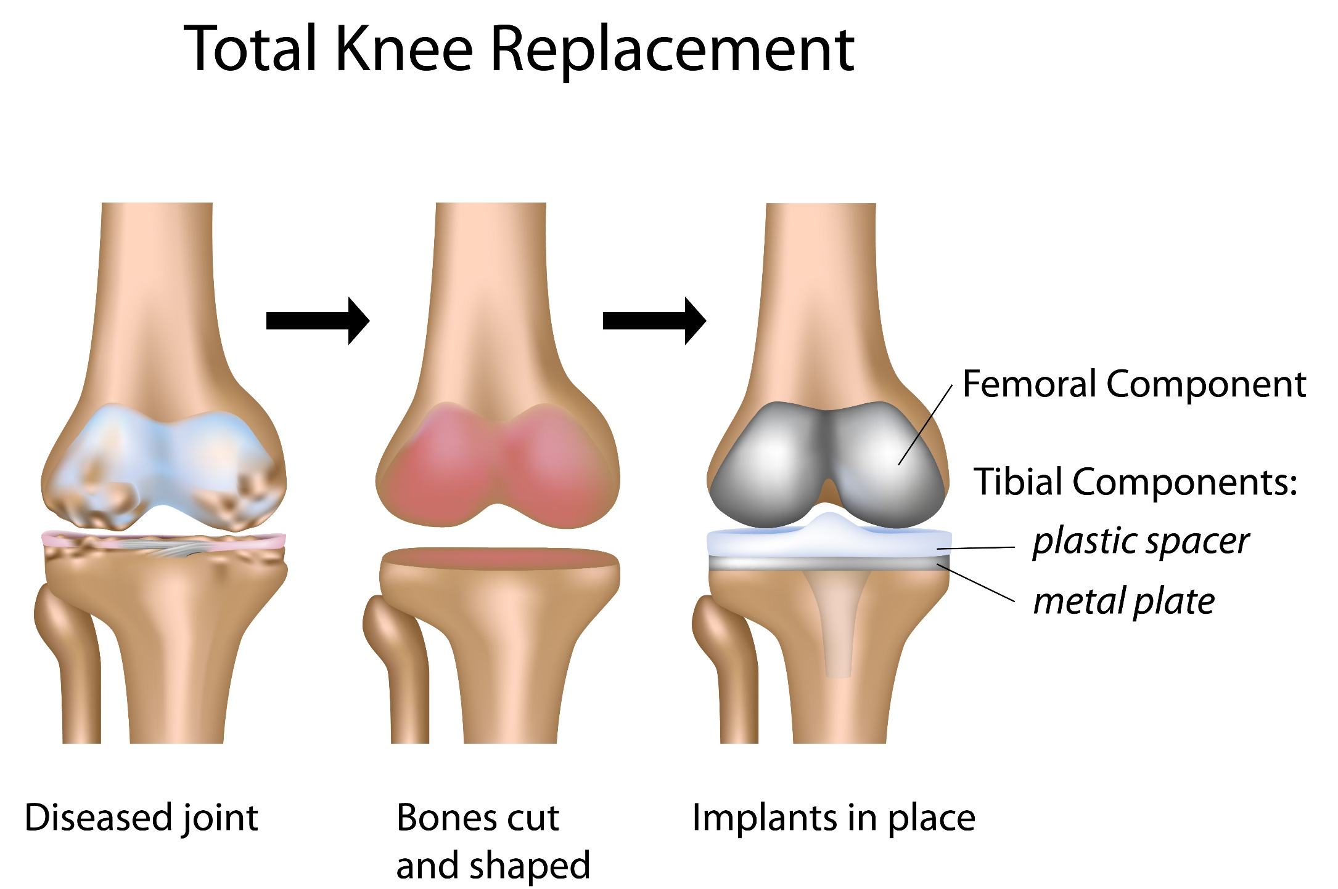

Slide 61
Learning check
Identify bony structures associated with the major joints
Explain the functions of bony structures associated with the major joints
Identify soft tissue structures located at the major joints
Explain the function of soft tissue structures located at the major joints
Explain the different types of joint-end feel
Describe the pathophysiology of common injuries/soft tissue dysfunction

