Slide 1
Conducting subjective and objective assessment
LO1: Anatomy and physiology of the major joints
LO3: Effects of anatomy, physiology and pathology on human function

Slide 2
Assessment criteria
LO1: Understand the anatomy and physiology of the major joints of the body
Identify bony structures associated with the major joints
Explain the functions of bony structures associated with the major joints
Identify soft tissue structures located at the major joints
Explain the function of soft tissue structures located at the major joints
Explain the different types of joint-end feel

Slide 3
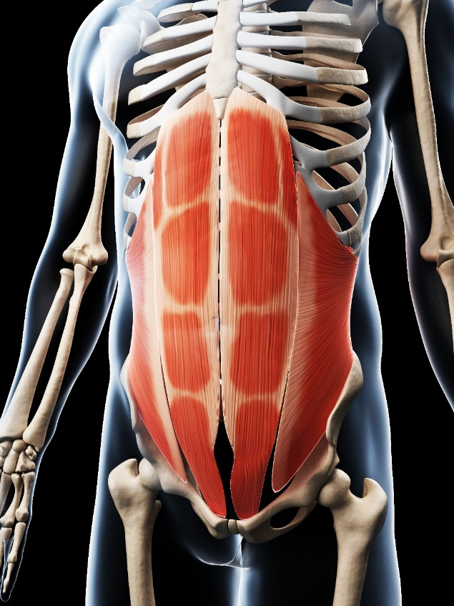
Stabilising muscles of the spine
Local postural stabilisers:
Lumbar multifidus
Transversus abdominis
Diaphragm
Pelvic floor muscles
Global phasic stabilisers:
Rectus abdominis
Internal obliques
External obliques
Erector spinae
Quadratus lumborum

Slide 4
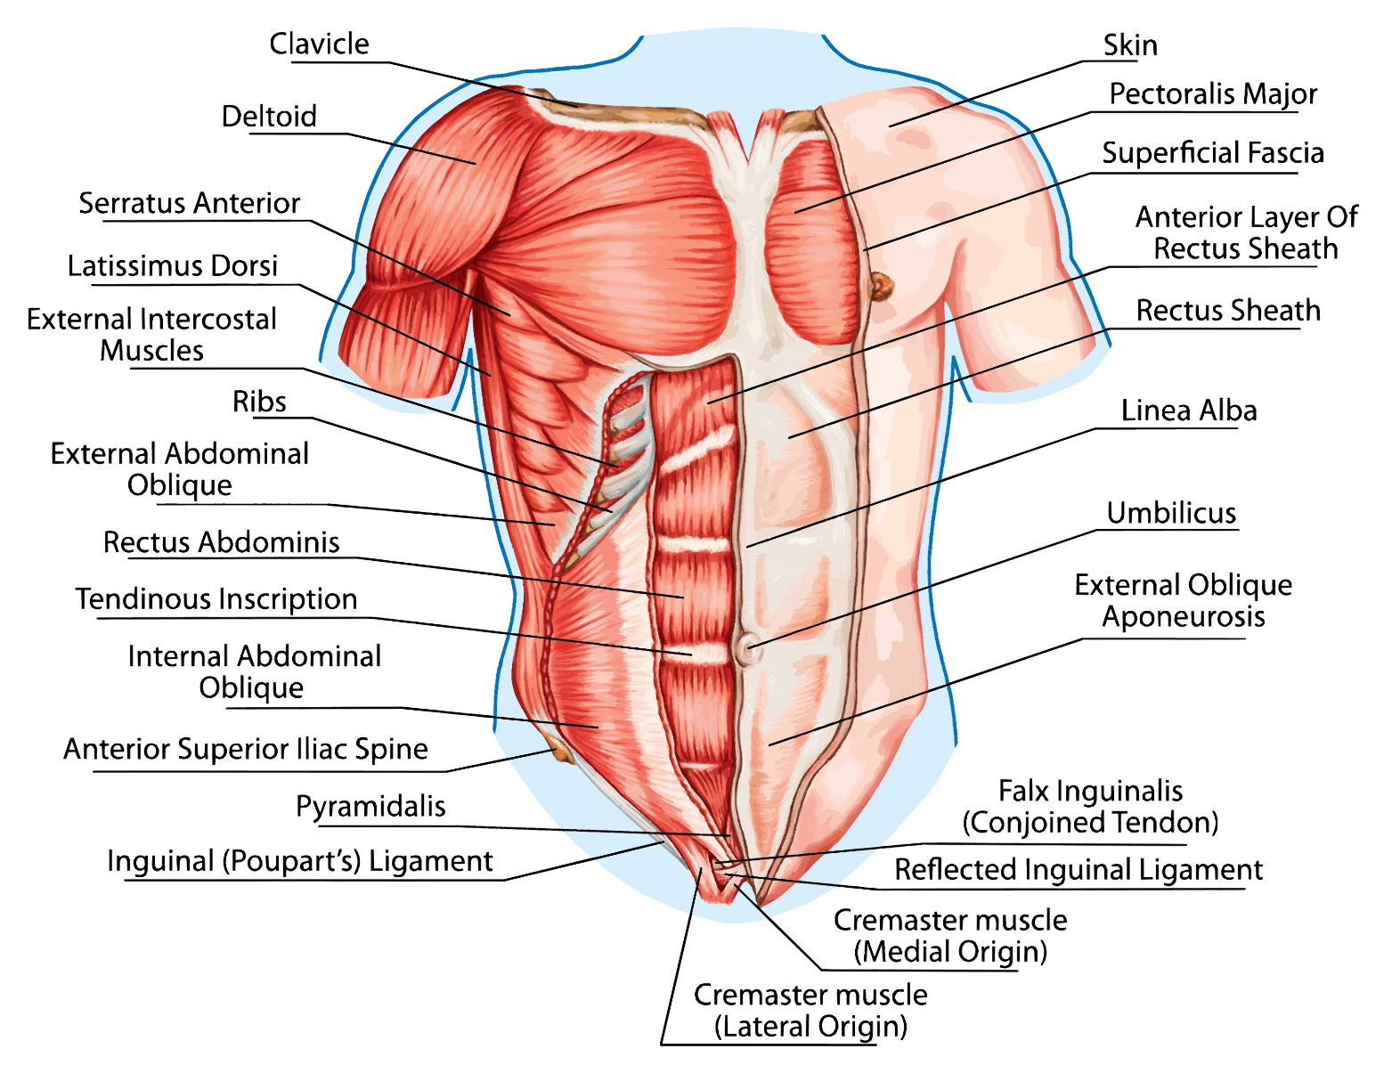

Slide 5
Spine flexors
Sternocleidomastoid – superficial
Scalenes – deep
Rectus abdominis – superficial
Psoas major – deep

Slide 6
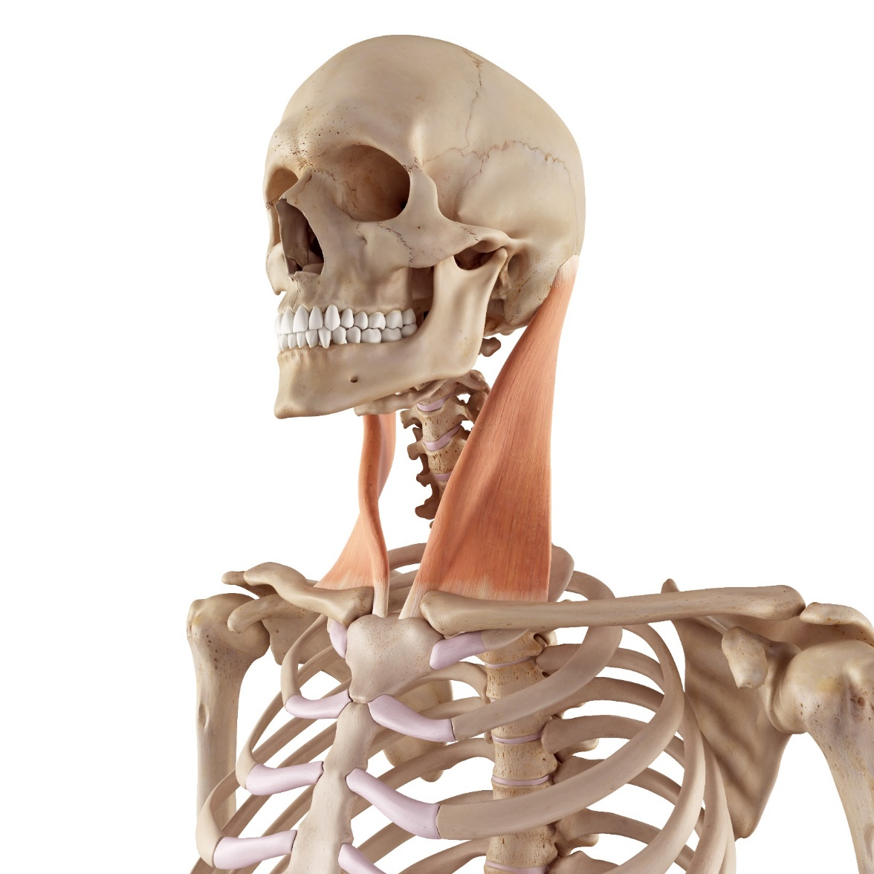
Sternocleidomastoid

Slide 7
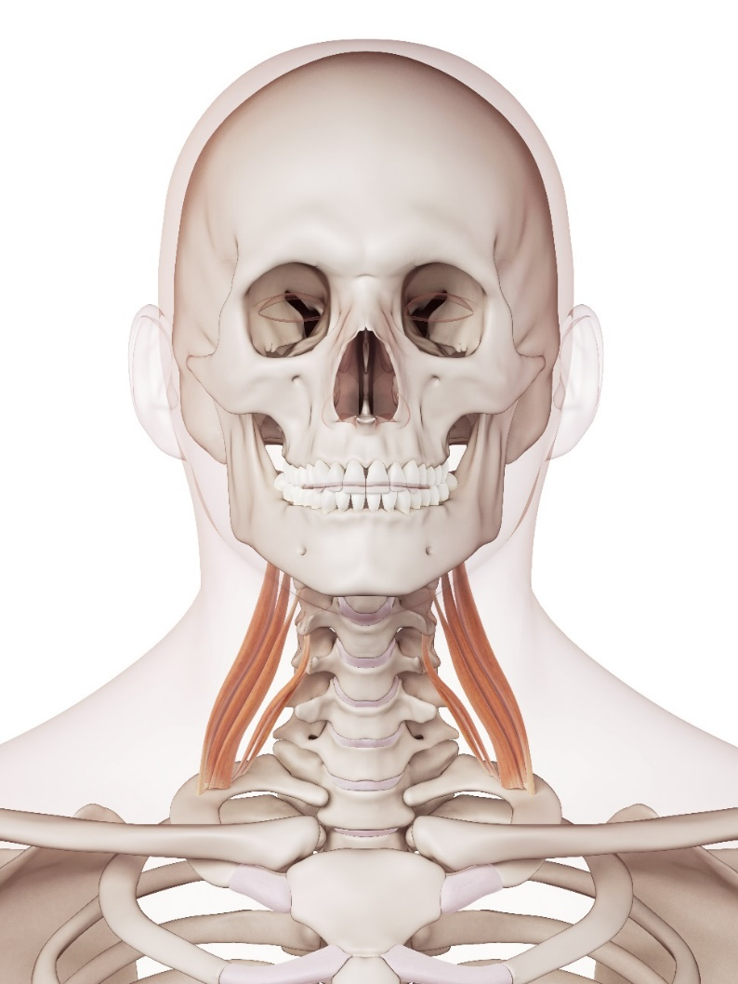
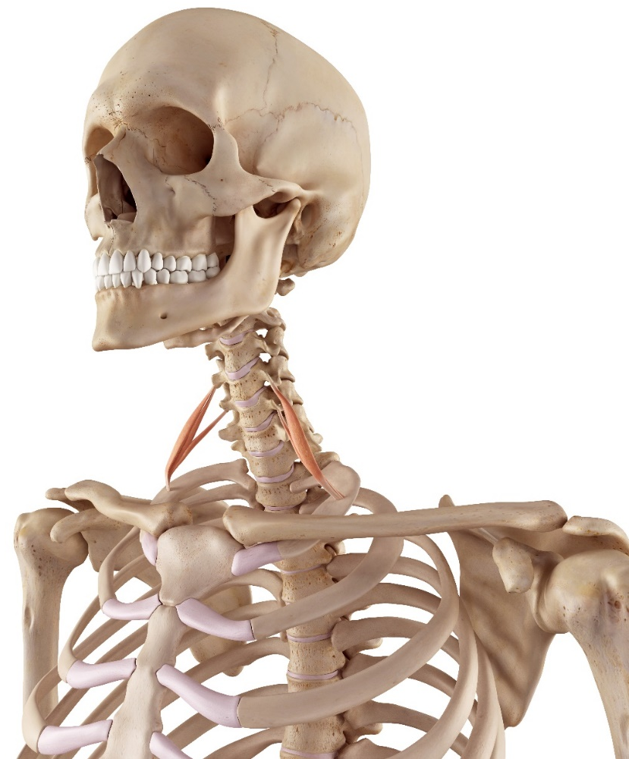
Scalenes – middle and anterior

Slide 8
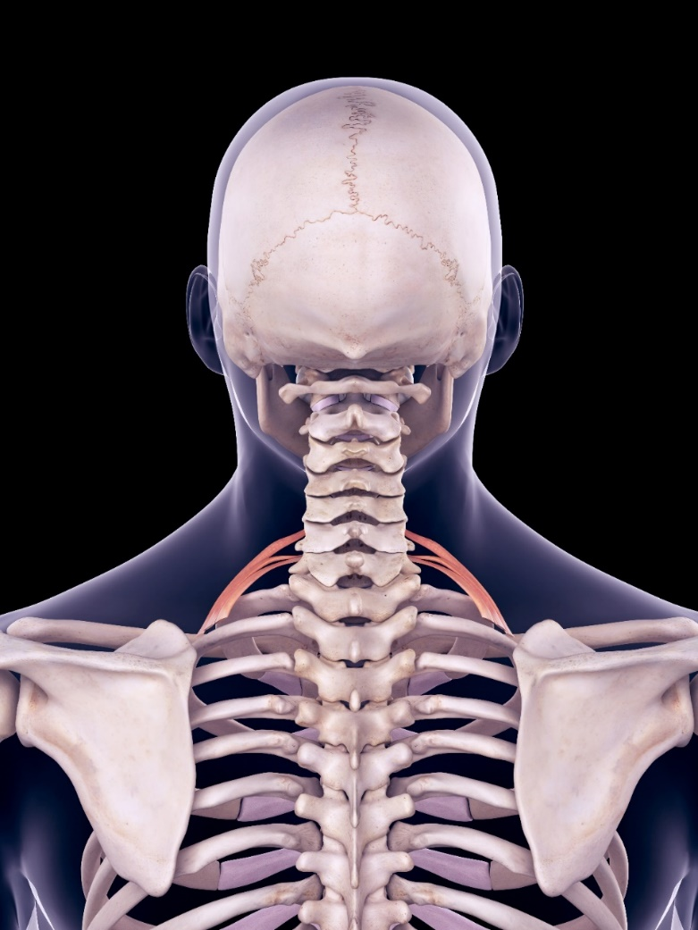
Scalenes – posterior

Slide 9
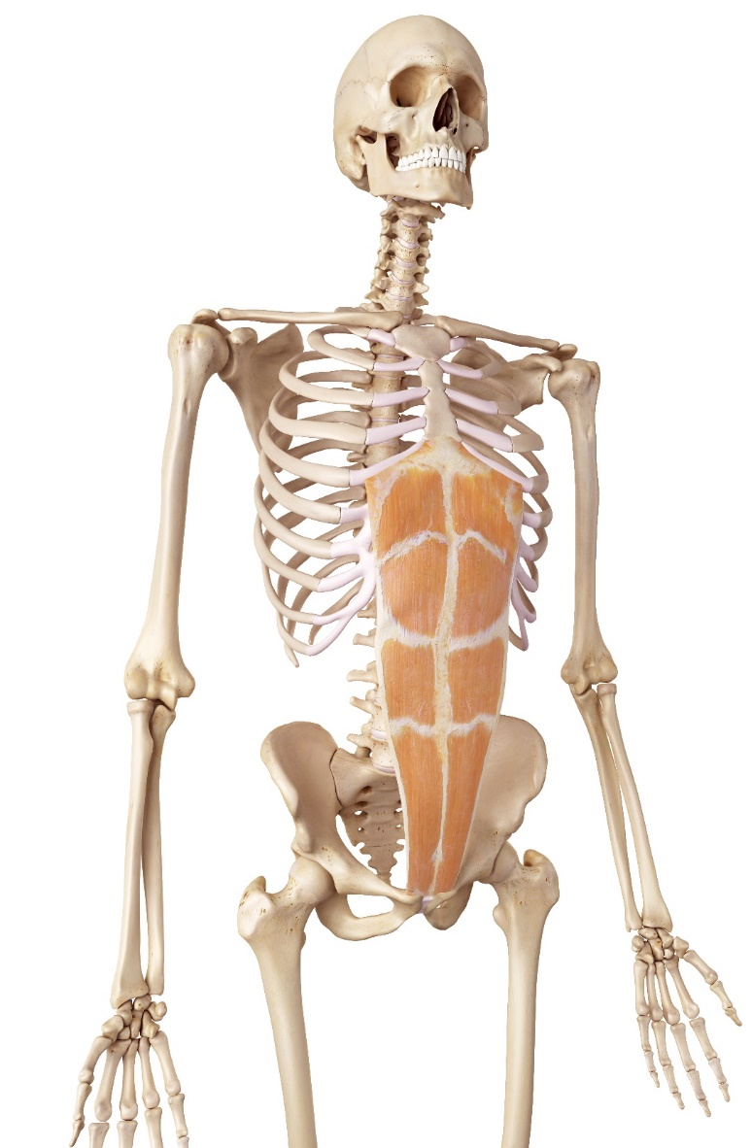
Rectus abdominis

Slide 10
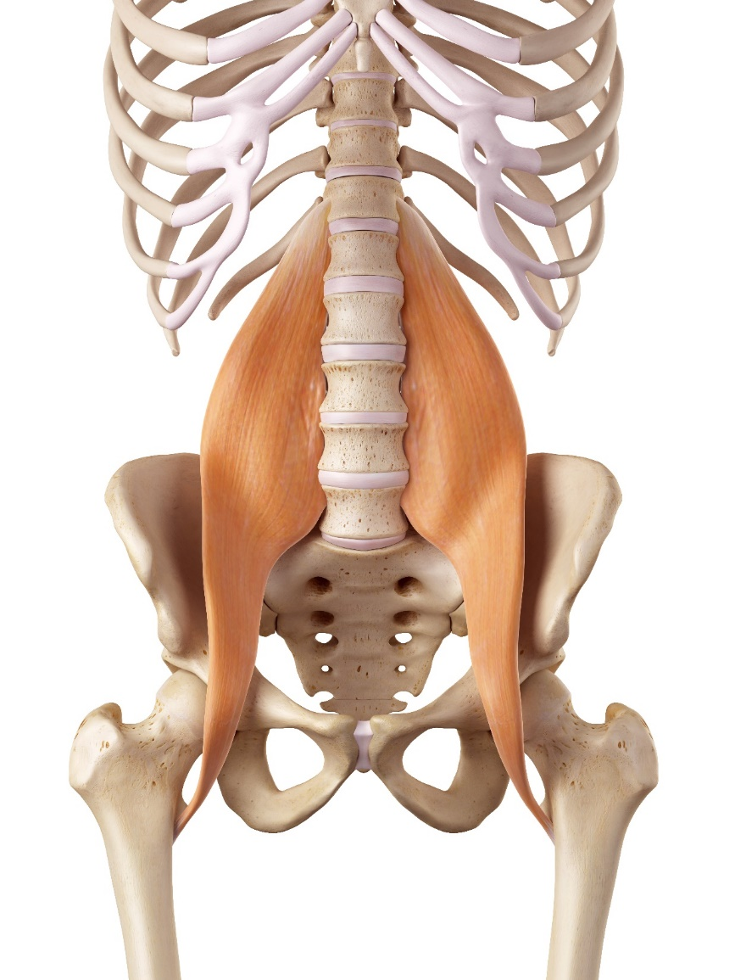
Psoas major

Slide 11
Spine extensors
Erector spinae – superficial
Multifidus – deep
Trapezius (upper fibres) – superficial
Quadratus lumborum (bilateral) – deep

Slide 12
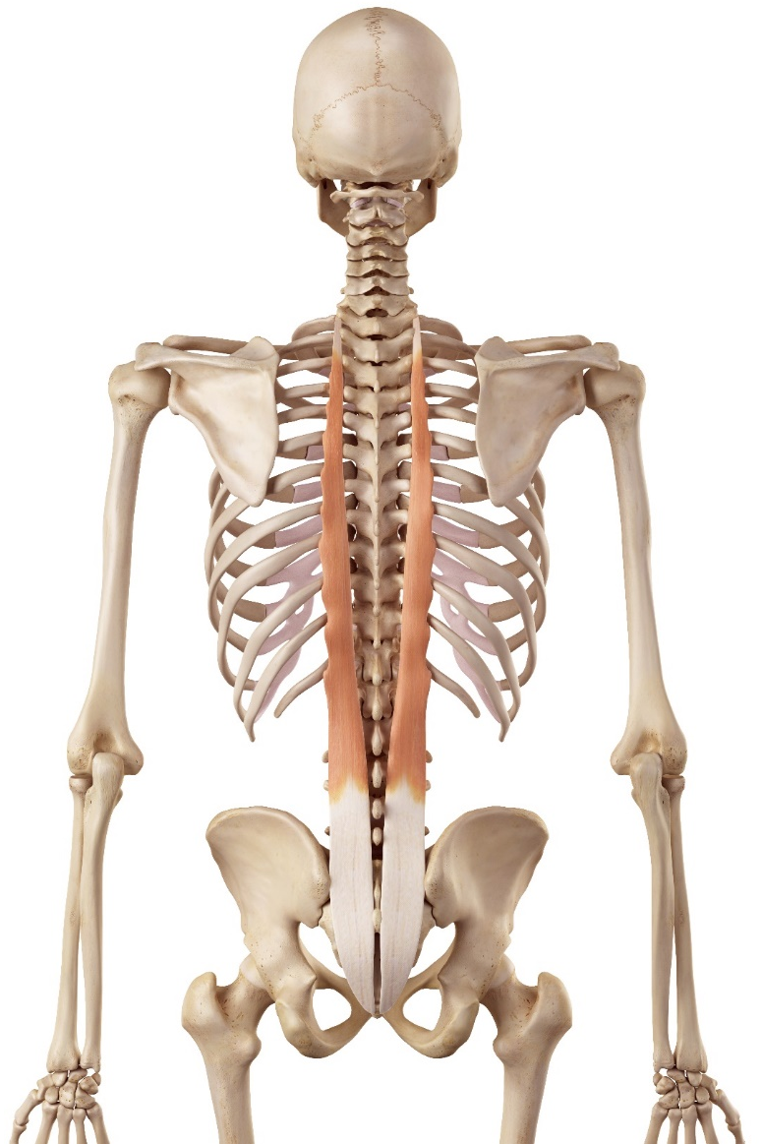
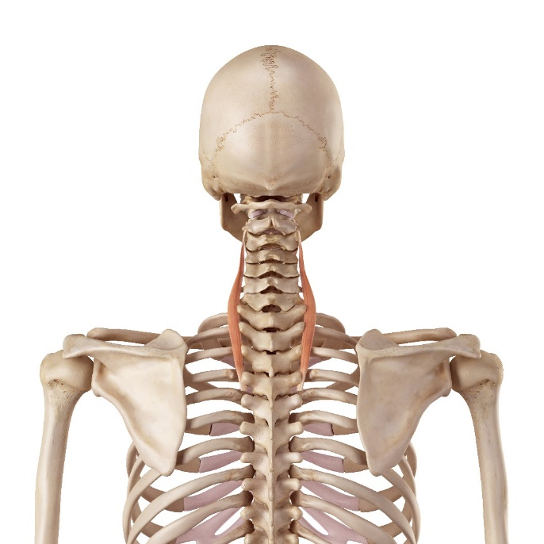
Erector spinae
Longissimus cervicis and thoracis

Slide 13
Erector spinae
Longissimus capitis

Slide 14
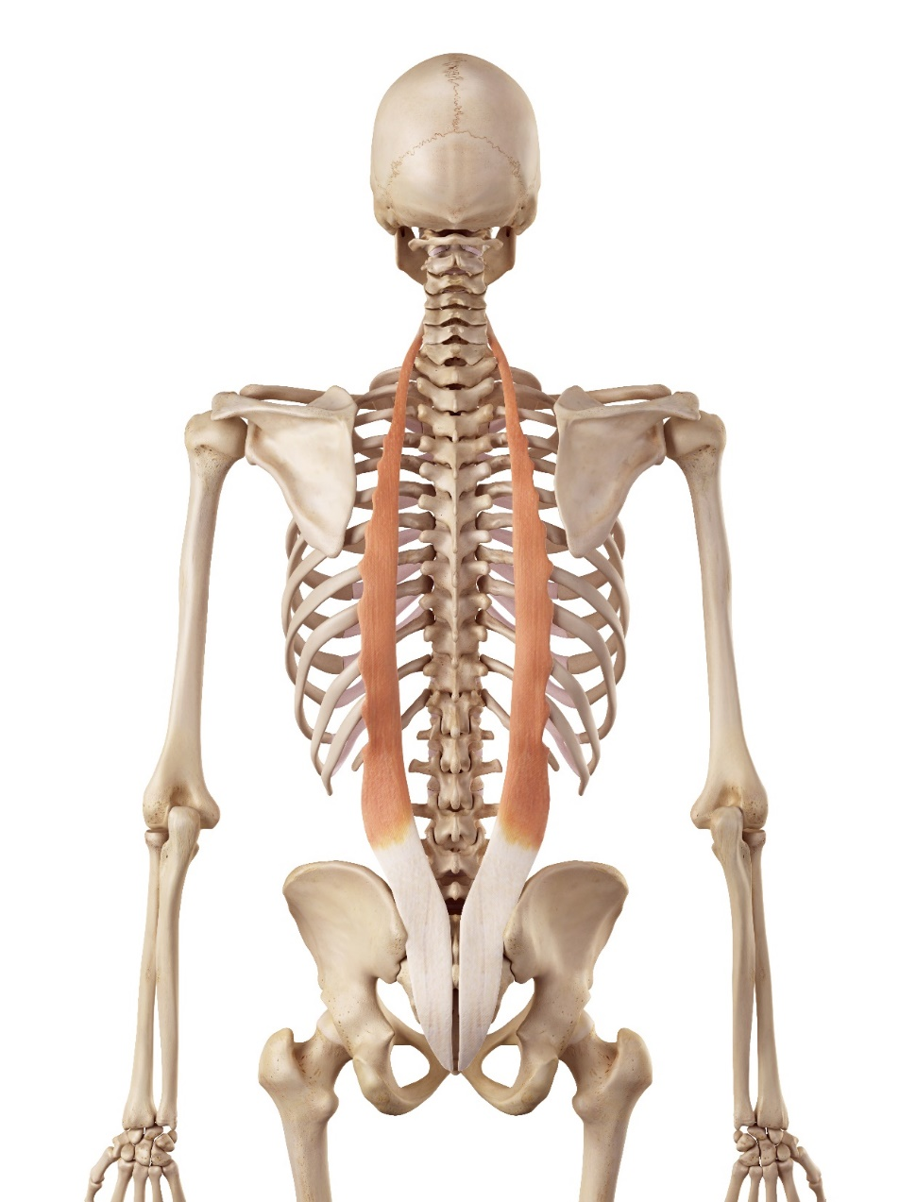
Erector spinae
Iliocostalis Cervicis
Iliocostalis Thoracis
Iliocostalis Lumborum

Slide 15
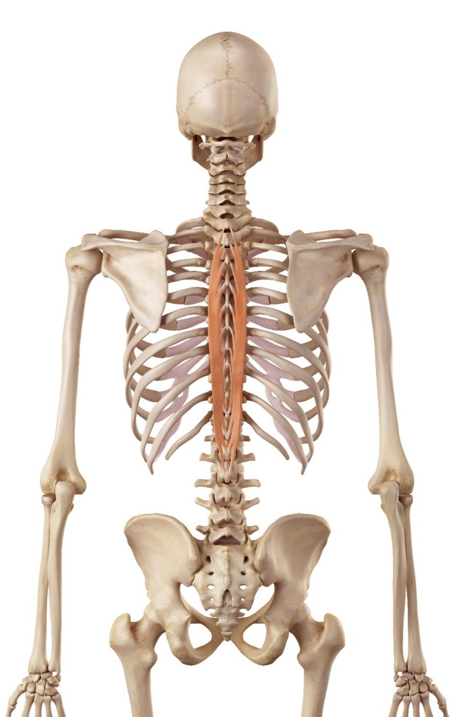
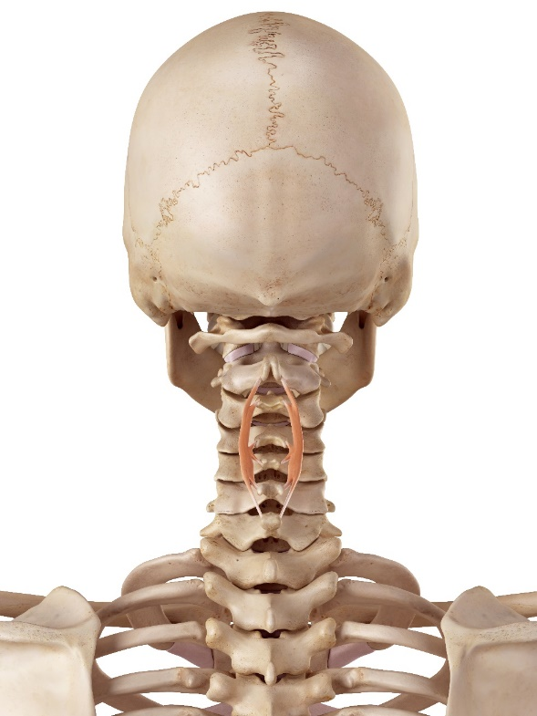
Erector spinae
Spinalis Cervicis and Spinalis Thoracis

Slide 16
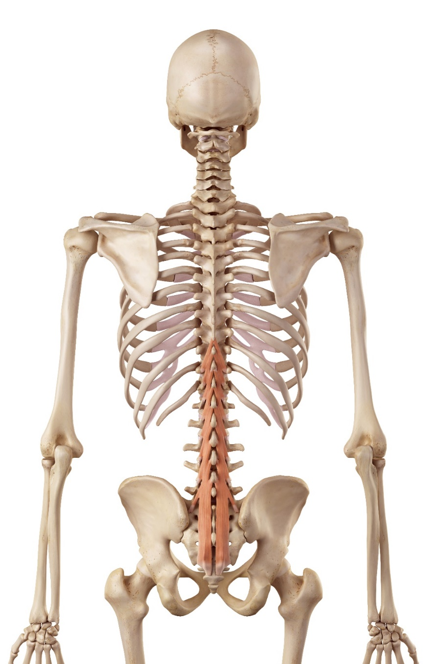
Multifidus

Slide 17
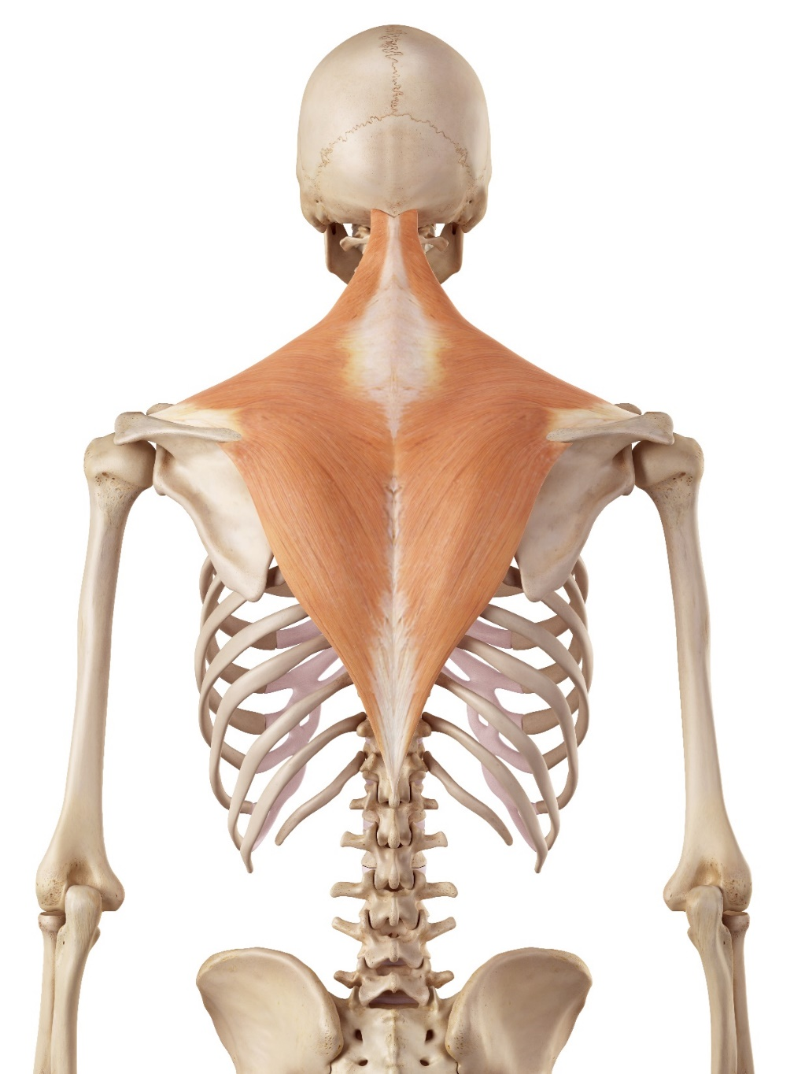
Trapezius

Slide 18
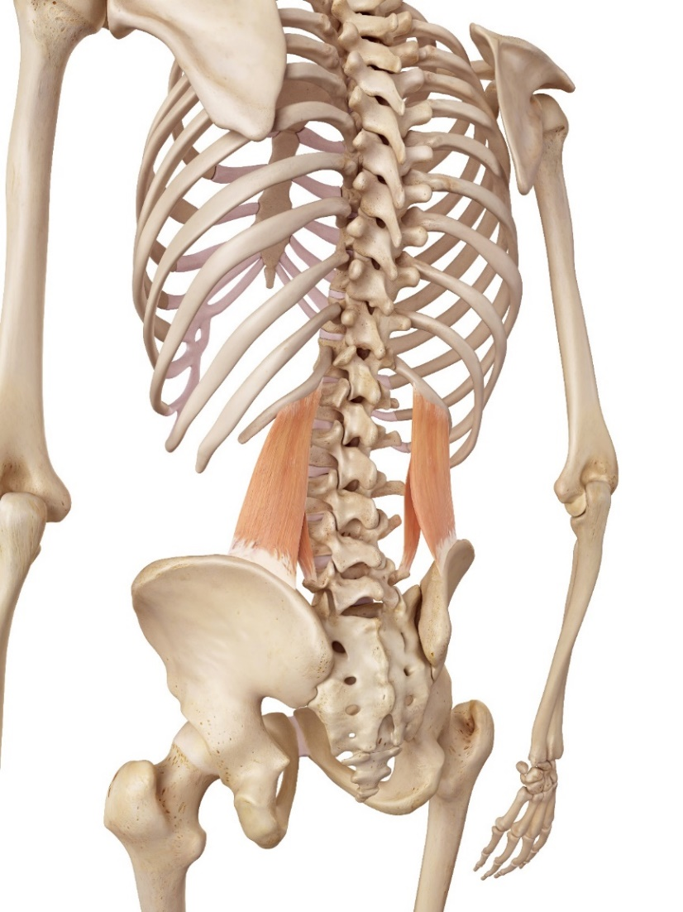
Quadratus lumborum

Slide 19
Spine rotators
Sternocleidomastoid – superficial
Scalenes – deep
External oblique – superficial
Internal oblique – deep
Multifidus – deep

Slide 20
Sternocleidomastoid

Slide 21
Scalenes – middle and anterior

Slide 22
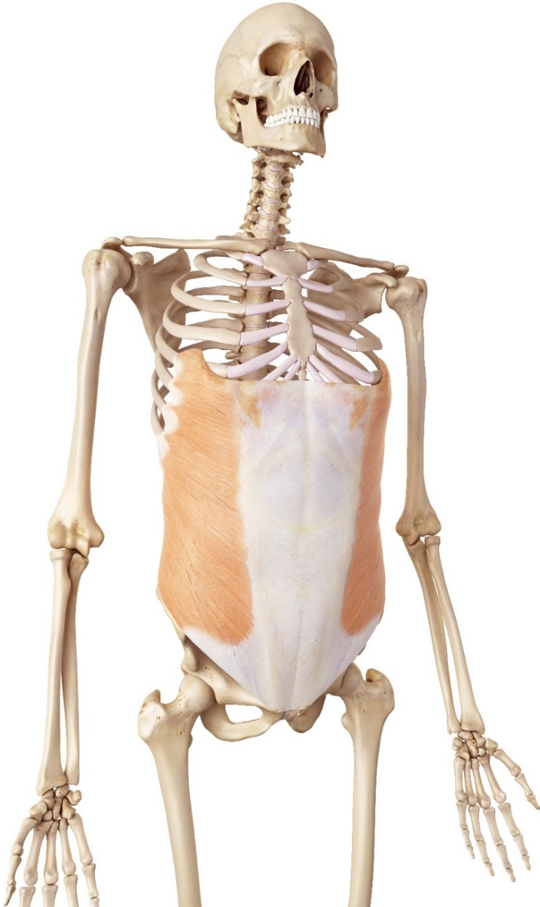
External oblique

Slide 23
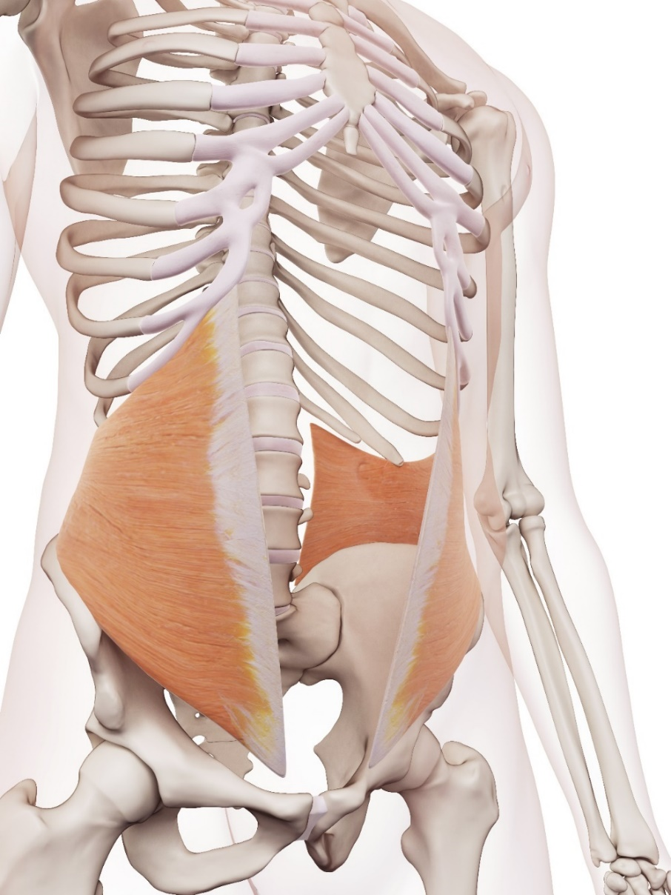
Internal oblique

Slide 24
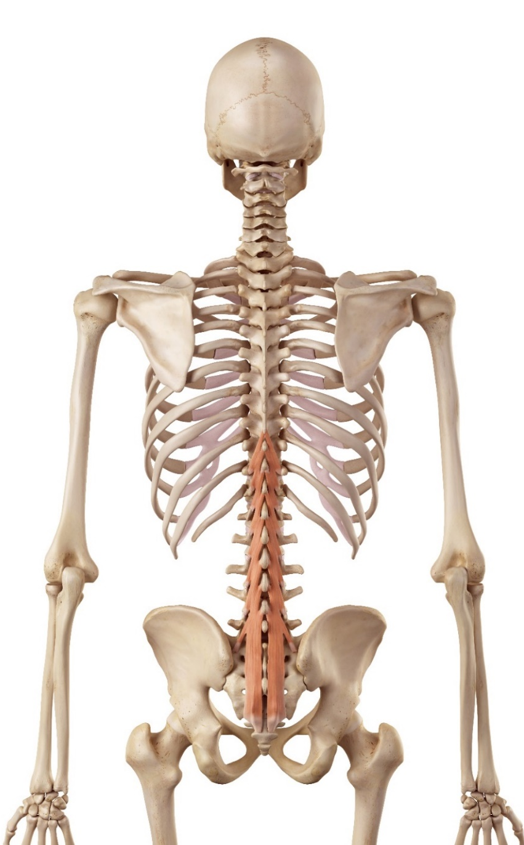
Multifidus

Slide 25
Spine lateral flexors
Trapezius – superficial
Sternocleidomastoid – superficial
Scalenes – deep
Levator scapulae – deep
Erector spinae – superficial
External oblique – superficial
Internal oblique – deep
Quadratus lumborum – deep

Slide 26
Trapezius and sternocleidomastoid

Slide 27
Scalenes – middle and anterior

Slide 28
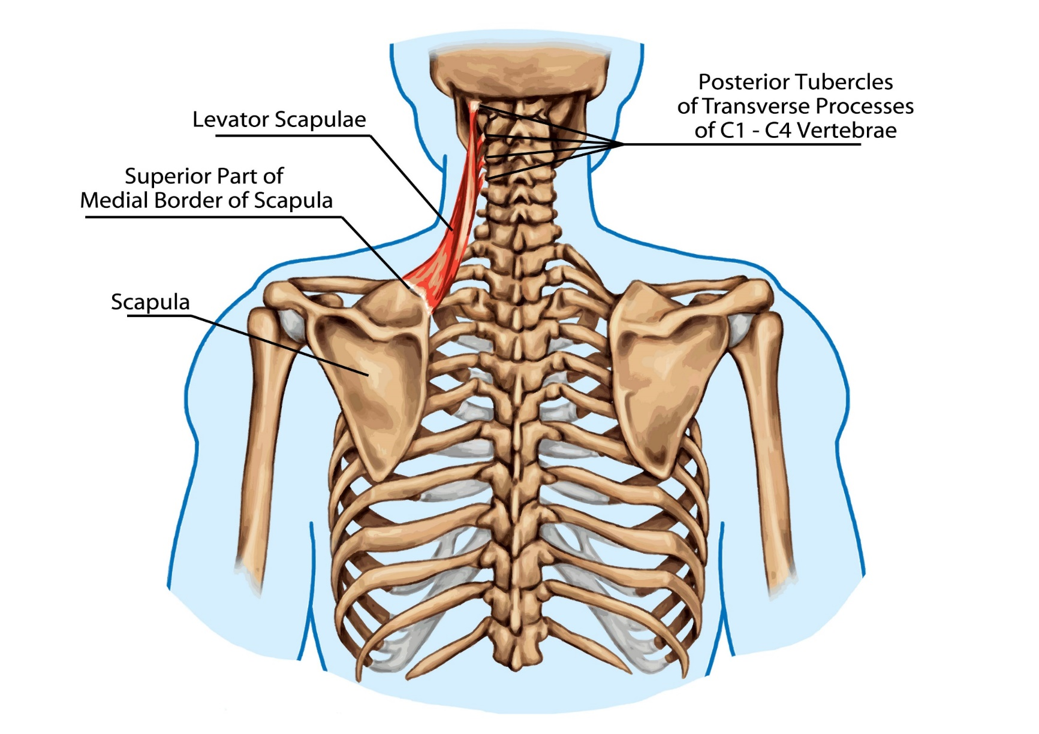
Levator scapulae

Slide 29
Erector spinae
Longissimus cervicis and thoracis

Slide 30
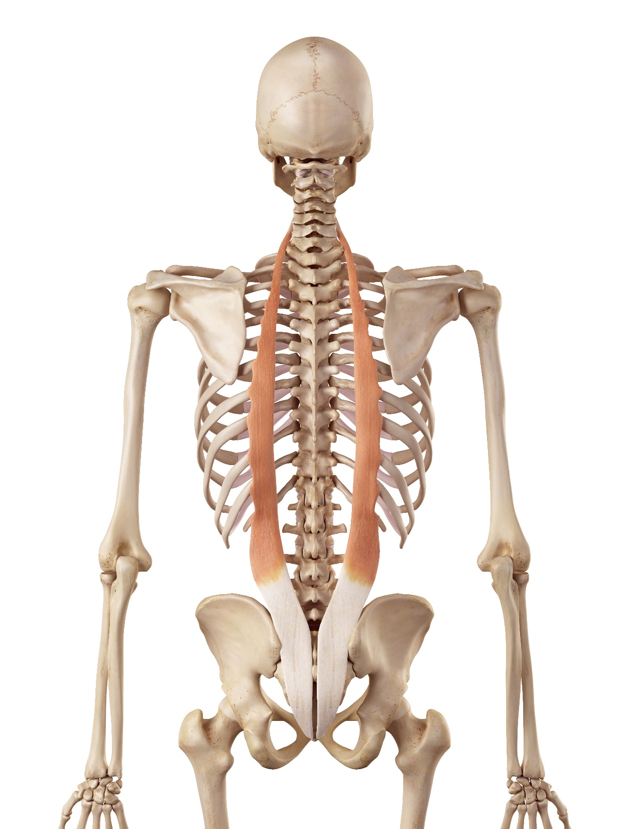
Erector spinae
Iliocostalis Cervicis
Iliocostalis Thoracis
Iliocostalis Lumborum

Slide 31
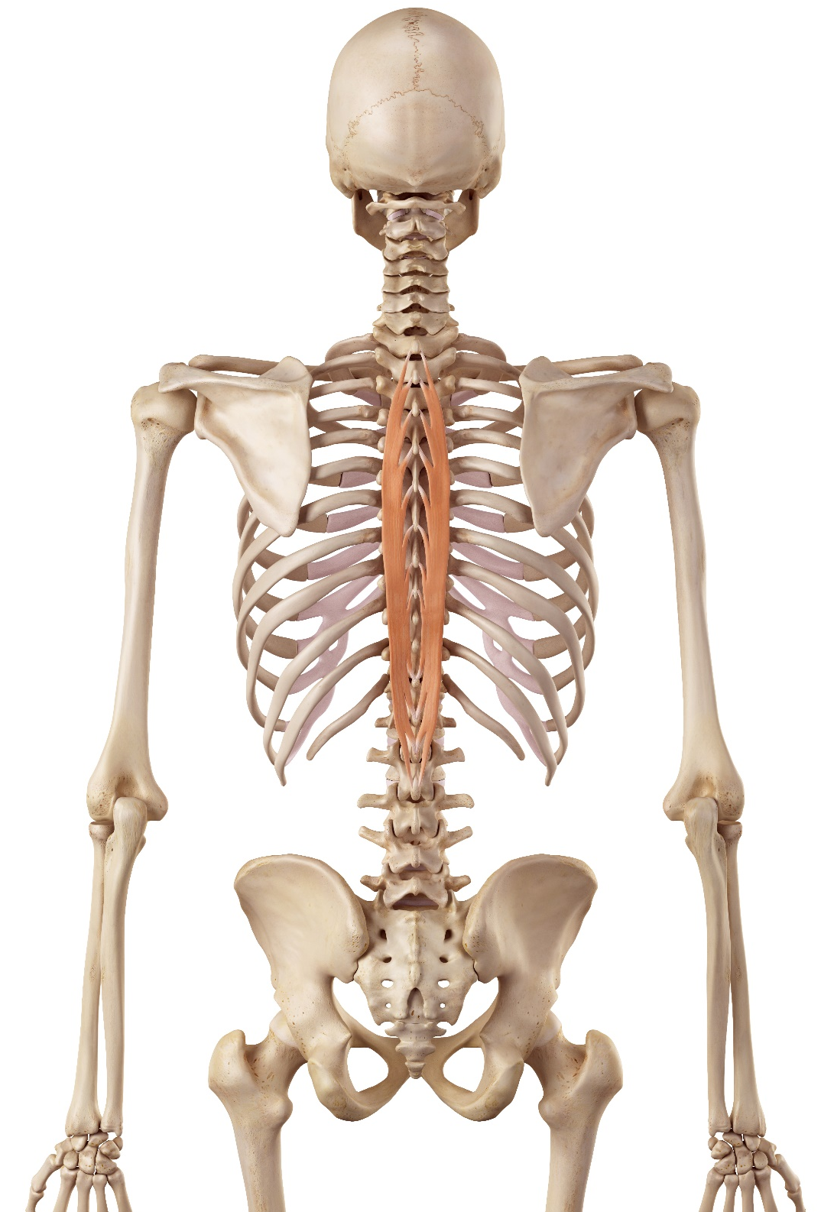
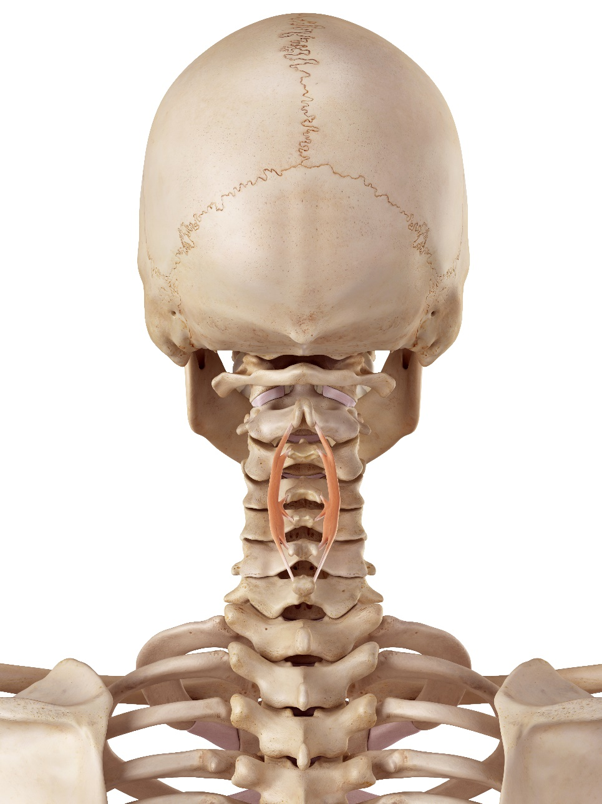
Erector spinae
Spinalis Cervicis and Spinalis Thoracis

Slide 32
External and internal oblique

Slide 33
Learning check
Identify bony structures associated with the major joints
Explain the functions of bony structures associated with the major joints
Identify soft tissue structures located at the major joints
Explain the function of soft tissue structures located at the major joints
Explain the different types of joint-end feel

