Slide 1




Lesson 4 - Presenting general nutritional advice

Slide 2

Learning objectives
By the end of the lesson you will be able to:
  Provide general nutrition advice for pre or postnatal clients participating in physical activity

Slide 3
General nutritional advice
Activity
Thought storm.
Discuss and note down key general advice, regarding nutrition for pre and postnatal clients.

Slide 4
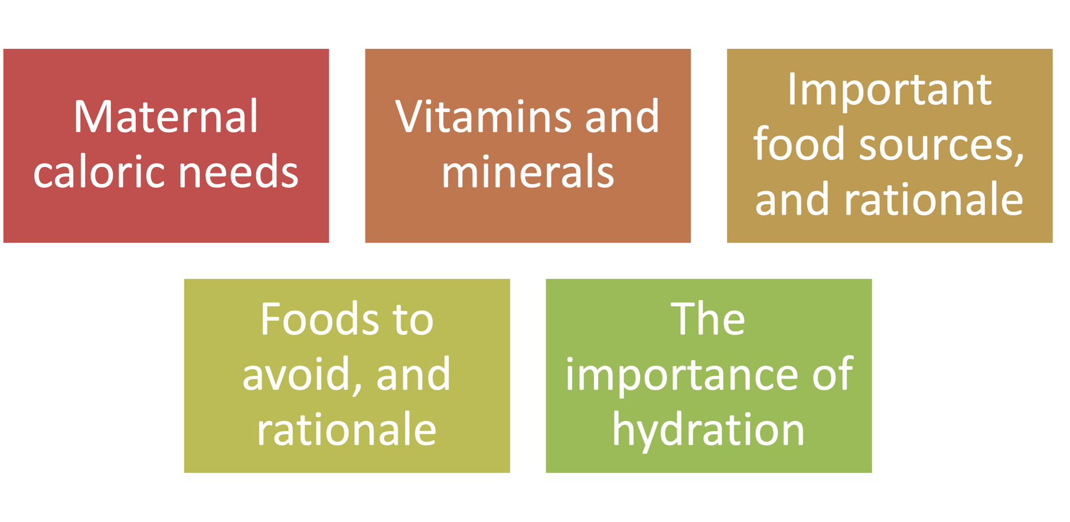
Presenting general nutritional advice

Slide 5
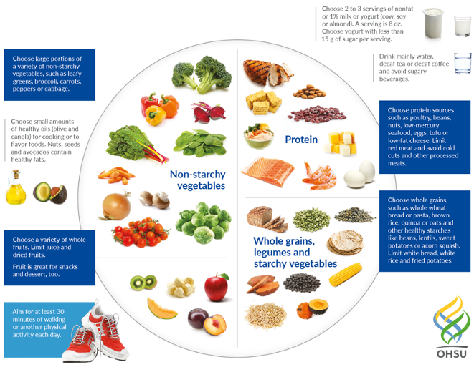
Presenting general nutritional advice

Slide 6
Managing risk
Activity
Design a poster presenting the following information:
•Maternal caloric needs.
•Vitamin and mineral recommendations.
•Important food sources and reasons for consuming them.
•Food sources to avoid, and why.
•The importance of hydration.

Slide 7
Learning review
Can you now:
  Provide general nutrition advice for pre or postnatal clients participating in physical activity?

